Slide 1

THE IMPACT SITE AND BUILDING MANUAL
Now featuring how to build things
By Wesley Huhn

Slide 2
THINGS TO CONFIRM
MMMMM
WHAT SCREWS TO USE FOR JOIST HANNGER
WHAT BIG BOI SCREWS TO USE
ARE LANDING POSTS SPLITING OR NAH

Slide 3
Table of Contents
1 - Title page
2 - Table of Contents
Building the Box
Hanging a Box
Building the Last Box
Hanging the Last Box
Building a Landing
Hanging a Landing
Building a Turn
Hanging a Turn
Building a U-Turn
Hanging a U-Turn
Decking Ramp sections
Building a Deck
Build in place
Frame First
Decking
Handrails
Skills
Miter Saw
Measure Cut Post
Design Guide – Reference when things change
Rules of Ramp
Rules of Deck

Slide 4
CAUTION SHEET
Call 911 in case of emergency
LEAD BASED PAINT
Houses built before 1979 may contain lead based paint. Paint sold after that time does not contain any lead compounds.
The two most common ways for lead to enter the body is by inhalation of lead dust and ingestion of lead paint chips or lead dust from the hands.
Those most susceptible to lead poisoning are very young children and pregnant or nursing women. Painting over lead based paint poses no health risk.
To be safe, assume the painted surface on an older house contains lead and follow these simple rules: NEVER sand a painted surface you suspect contains lead.
ASBESTOS
Asbestos is a mineral fiber that was used extensively in older homes in a variety of products and applications such as floor tiles, ceiling tiles, exterior siding, and attic insulation.
It is the microscopic fiber that, when inhaled, poses a significant risk factor, especially in large quantities and in people who smoke. As long as the fibers are locked into their product and not airborne, they pose no risk.
For our purposes, we should avoid removing or handling any asbestos product in a manner that would release the fibers into the air. Standard dust masks offer no protection from the microscopic fibers.
It is not unusual to encounter asbestos siding on an older home. This product is typically 12” x 24”, about 1/8” thick, and installed on exterior sides with pieces lapping over the top of each other similar to roof shingles. They are very brittle and often times the bottom pieces are cracked and chipped. For missing pieces, a replacement product is available that does not contain asbestos.
Asbestos siding can be safely water cleaned and painted with no health risk. Do not sand, scrape, or use a wire brush on asbestos siding.
BIOHAZARDS
Latex gloves are required equipment when cleaning the inside of a client’s home of debris and refuse.
Latex gloves will give added protection from unknown hazards and unsanitary conditions.
Old medical equipment and medical supplies should be avoided if at all possible.
Avoid picking up hazardous materials such as hypodermic needles, sharp objects, old car batteries, condoms, animal carcasses or any questionable object.

Slide 5
Set up the Site
Set up Tools
Fill out safety sheet
Set up pop up if needed
Asses as a team what work needs to be done
…
PRAY!!

Slide 6
How to Demo

Slide 7
Common Materials
Screws
3 in Deck Screws Tan
3 in Structural Screws Black
2 ½ Deck Screws green
1 ½ Metal Connector Screws Silver
Bo

Slide 8
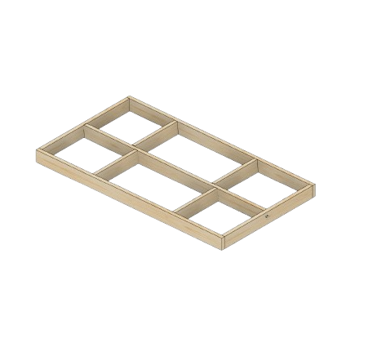
The Box
How to build the frame of boxes that are used in wheelchair ramps
Materials needed
3 2x6xLength of box
2-3 2x6x8
42 3in Deck Screws
Tools needed
Chop saw
Drill/Impact Driver
Framing/Speed Square
For instruction on how to build the last box
Turn to “fuie”
For instruction on how to Hang a box
Turn to “fuie”
For instruction on decking and handrails
Turn to “fuie”
To better understand your deck's design
Turn to "fuie"

Slide 9
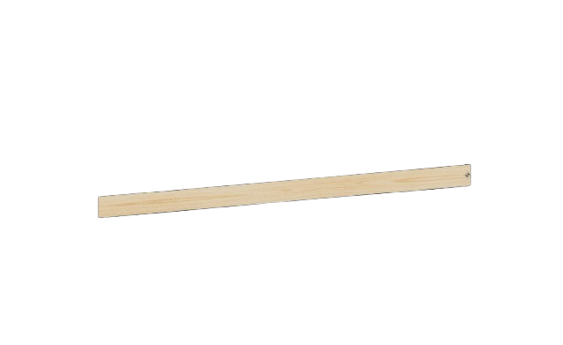
Building a Box – Design the Box
When getting ready to create a new box for a ramp you must take into consideration how it fits into the overall design
If it is the Last Box you need to turn the dedicated last box section.
If it is not the last box, then you must check to see if the angle of the slope should be cut.
The angle of the slope will need to be cut in these conditions
Going to a flat section
Landing
U-turn
Starting a sloped section
First box
From a flat section
The only time a box will not have angle cut into it is coming from a sloped section and going to a slope section.
Add pics of opts
Going to flat
Starting a slope
Note 1
There might be boxes that need angles cut on both sides
Note 2
The angle cut should be “falling”, when two sides are cut, they should be parallel

Slide 10

Building a Box – Cutting Boards
Boards needed
1 – 2x6xLength
1 – 2x6x8
Proceed with only Step 1 in the “Default cuts” section
Step 2
Get 1 of the 2x6 that is the length of box. Cut 3 inches off one side. At the angle on either or both sides that is needed. This is your middle joist.
Step 3
Get the other 2 2x6s that are the length of the box and cut the angles need on the ends.
Default cuts
Step 1
Get 1 2x6x8, cut it twice. So that it makes two 45-inch boards. These will be the ends of the box.
Step 2
Get 1 of the 2x6 that is the length of box. Cut 3 inches off one side. This is your middle joist.
Redo
Do I need to cut an angle on either side of the box?
The angle of the slope will need to be cut in these conditions
Going to a flat section
Landing
U-turn
Starting a sloped section
First box
From a flat section
Note
There might be boxes that need angles cut on both sides
To Figure out how to cut an angle turn to page “FJOE”
Going to flat
Starting a slope
The angle cut should be “falling”, when two sides are cut, they should be parallel

Slide 11
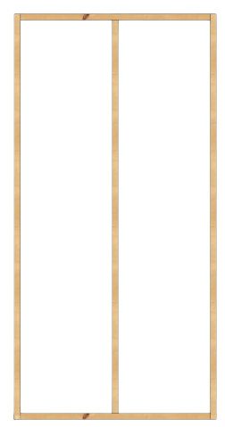
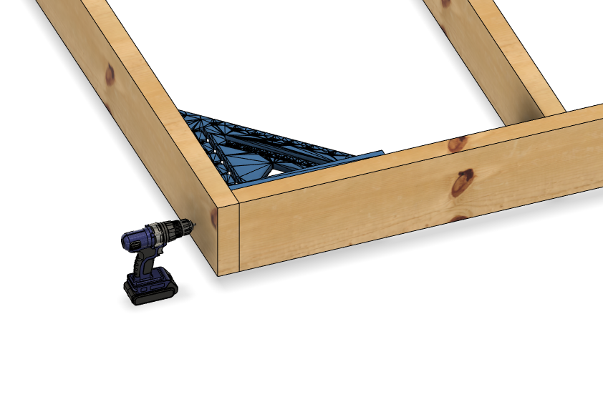
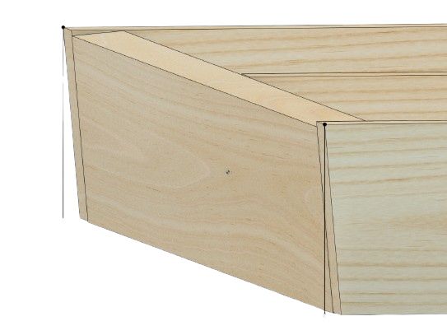
Building a Box – Assembling Frame
Boards needed
2 2x6 sides
1 2x6 middle
2 2x6 ends
Speed square
Connecting the Frame
Step 1
Align the two boards in the correct way. Use a framing or speed square in order to make sure it is square.
Step 2
While maintaining square, screw in three 3in deck screws. One in the top middle and bottom.
Angles sides
When attaching the end boards to the sides, ensure the angles align correctly. A speed square will not sit flush against the angled edge, so verify that the top of the end board is flush with the top of the side board.

Slide 12
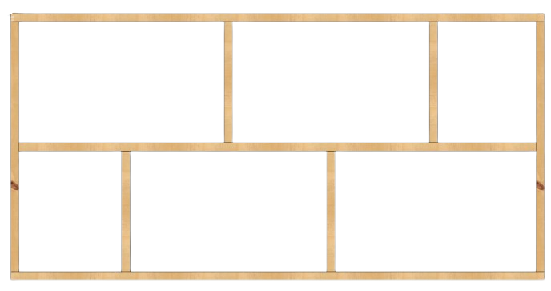

Building a Box – Middle Supports
Boards needed
1-2 2x6x8
19.2 on center spacing
Adding the middle supports/blocking
Step 1
Mark the spacing on the boards.
Step 2
Measure and cut each section. The lumber is warped each section should be measured and cut.
Step 3
Attach the supports with three 3in deck screws. Making sure to flip the side of every other board
Your Box is Done!
Length of Box | Amt. of supports | Spacing
8 ft | 4 | 19.2 in
10 ft | 6 | 17.14 in
12 ft | 6 | 20.57 in
16 ft | 8 | 21.33 in
$$\frac{Length}{ Supports+1}=Spacing$$
Note:
Middle supports don’t provide any lateral support; they prevent the middle support from warping. So, spacing does not have to be super accurate

Slide 13
Building a Box – The last box Concrete
The last box
Method 1 – Landing on concrete
When making the box you will need to cut the side and middle 2x6s and the inverse angle of your slope. (Ex. 85 degrees if slope is 5). This will leave your frame landing to nothing. There will be no front board
You will need to notch a space for a 2x4 about 2 ft back in your box. So, you can attach 4x4 effectively.

Slide 14
Building a Box – The last box Dirt
Landing in dirt
When making the box cut a “pie” out of the middle and sides. So that less digging is involved in the project.

Slide 15
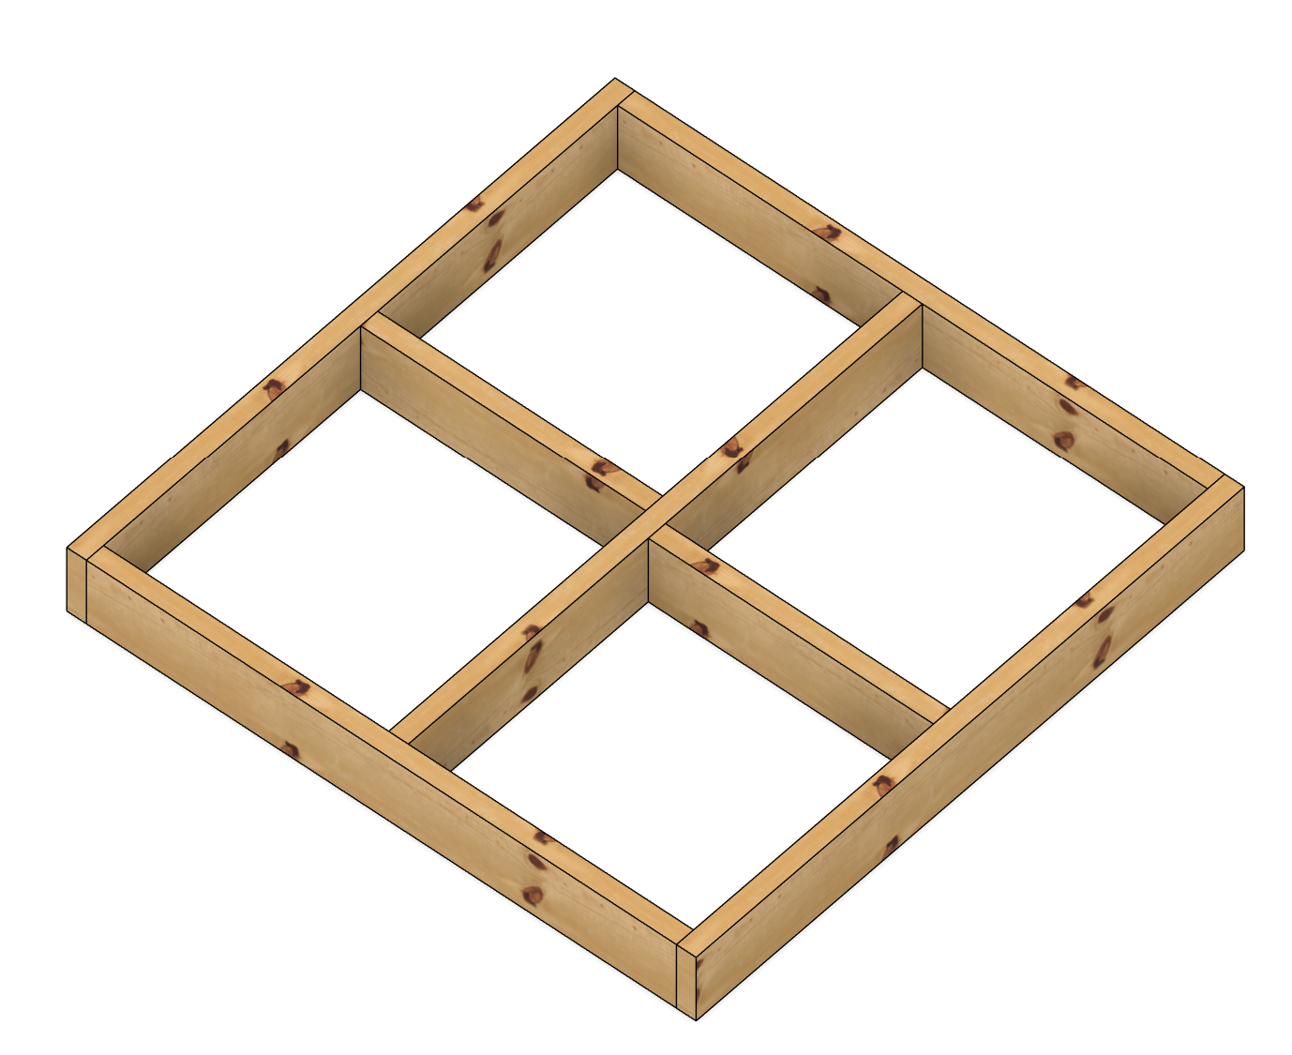
The 4x4 Box
How to build a 4ft-by-4ft frame. Used in landings and turns.
Materials needed
3 2x6x8
30 3in Deck Screws
Tools needed
Chop saw
Drill/Impact Driver
Framing/Speed Square
To better understand your Ramps design
Turn to "fuie"

Slide 16
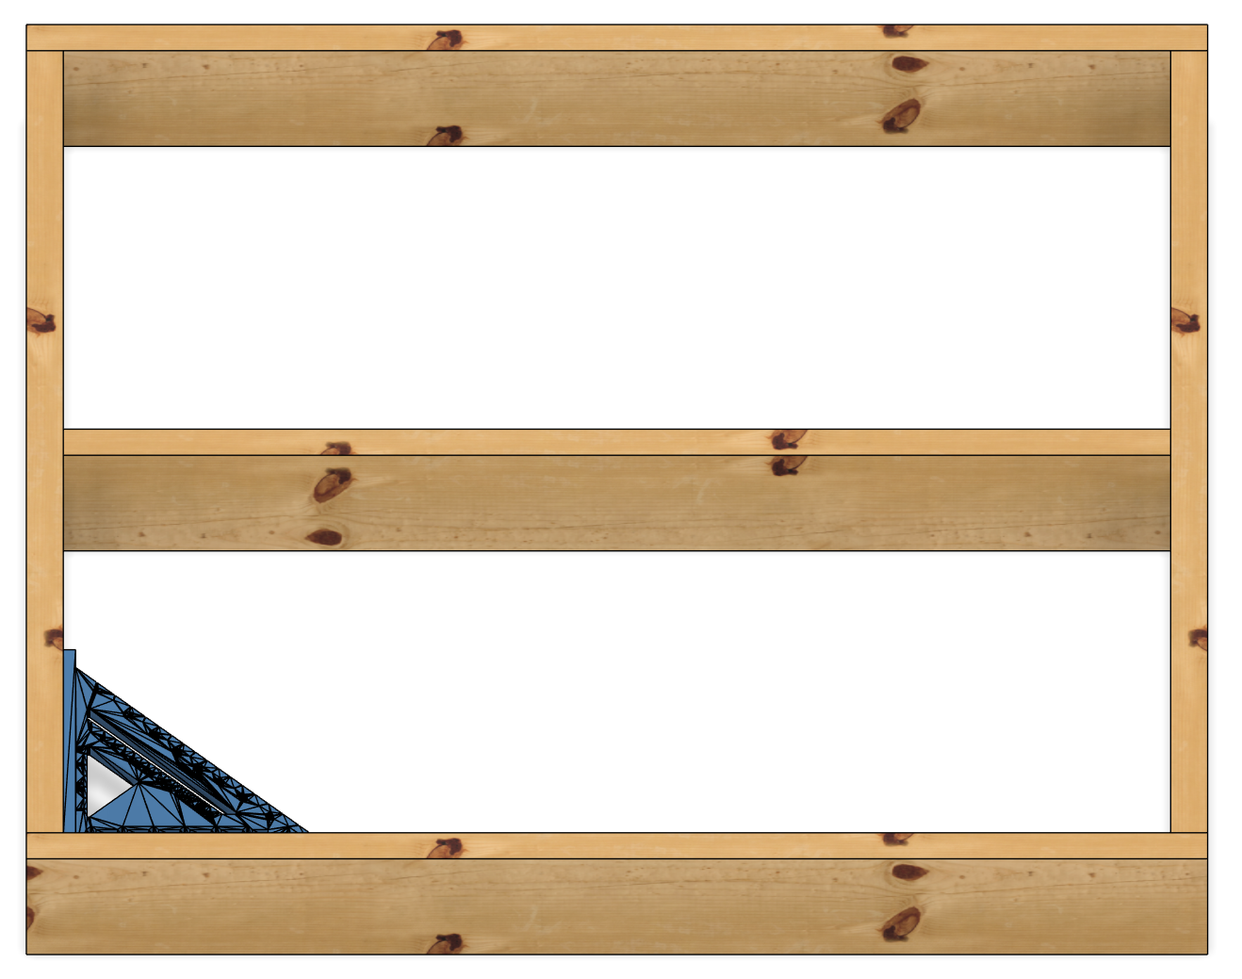
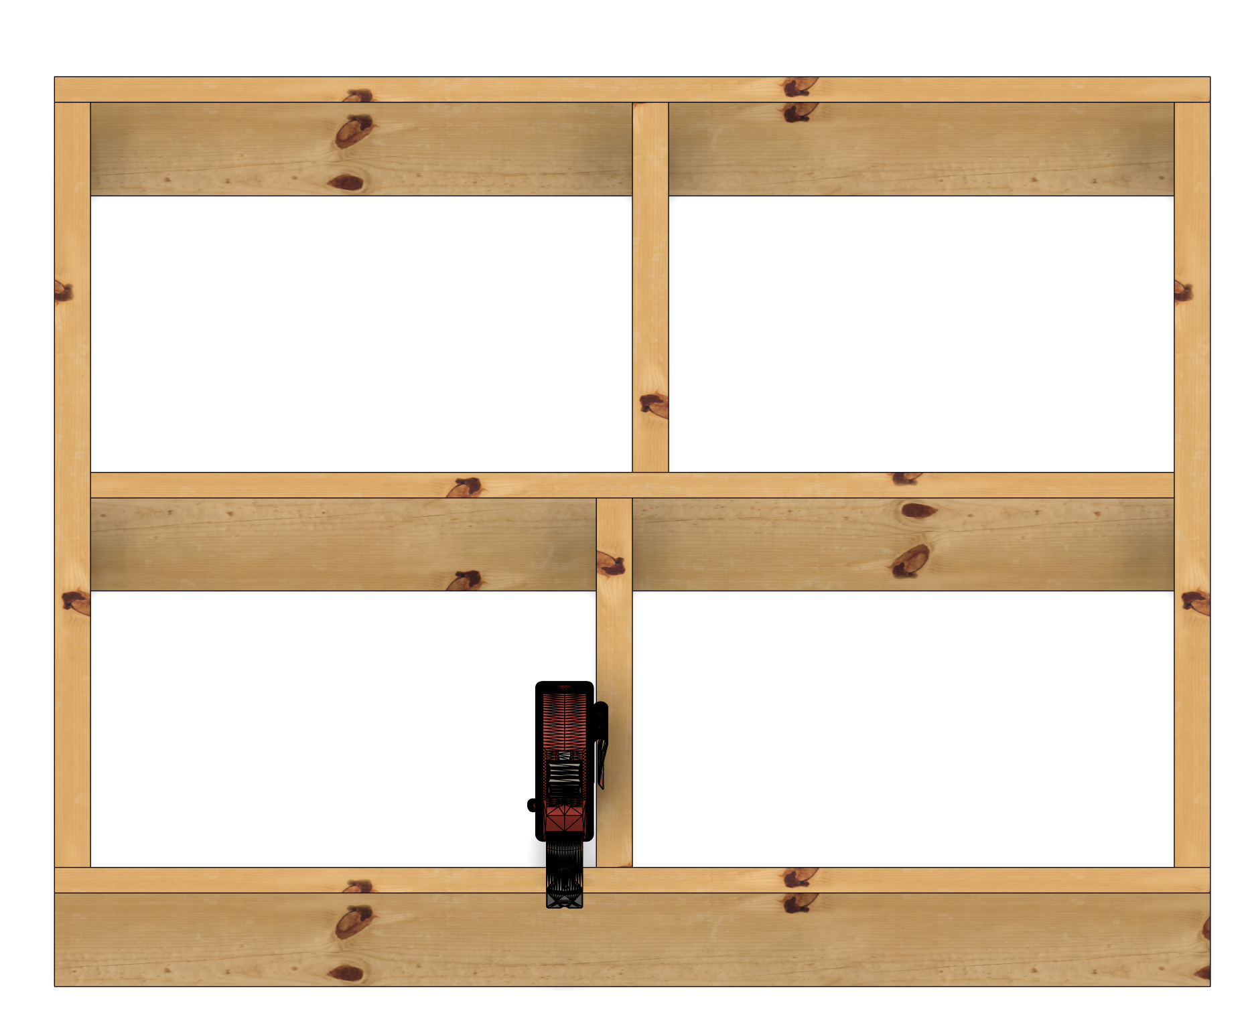
The 4x4 Box – Frame and supports
Frame and supports
Step 1
Cut two 48 inch sections from one 2x6
Cut three 45 inch section from two 2x6s
Step 2
Square each connection and screw together with three 3in screws
Step 3
Measure 2 supports in the middle, and cut them out of the rest of 2x6
Step 4
Square and screw in the supports
45in
48in
48in
22.5in
21in

Slide 17
The U-turn
How to build a U-turn
Materials needed
To better understand your deck's design
Turn to "fuie"

Slide 18
The U-turn – Frame and supports

Slide 19
The U-turn – Handrails

Slide 20
Hanging a Box
How to attach a box in each scenario you will come across
Materials needed
1 Box
2-6 4x4 posts
Temp Support piece
Tools needed
Drill/Impact Driver
Chop saw
Post level
4 ft level

Slide 21
Hanging a Box – General Process
General Process
Step 1
Determine how many posts you are adding. Then determine if a post hole is needed, or if a paver or block will be used per each post.
Step 2
Move the new section being added into place, leveling it to an existing structure or previous Box
Step 2a:
If it is a ramp determine the slope, and move the box as such
Step 3
Mark handrail height (36 inches) on all the posts, and add the angle needed to be cut
Step 5
Cut the Posts
Step 6
Move the section being added back into place, as well as the posts
Step 7
Level the section added as needed. Level the posts
Step 8
Attach Frame to the posts with 3inch screws, add a cleat or structural screws
Step 9:
Add temporary support if needed
Step 10:
Cleat each post
For instruction on how to level a post​
Turn to “fuie“
For instruction on how to Set a box’s slope​
Turn to “fuie“

Slide 22
Hanging a Box – First Box
Hanging a box
New Post added
2
Follow the “General Process” but take into consideration
Posts
The front posts will be fully inset
The back posts will depend on the next feature
Note 1
When the moving the frame into place for the width to match the level of the surface you're coming from.
Note 2
Do NOT try to set all 4 posts at once, treat as 2 sections the front and back. Use a scrap board to hold the slope when working on the back.

Slide 23
Hanging a Box – Going and coming from a Box
Going and coming from a Box
New Post added
2
Follow the “General Process” but take into consideration
When coming from a Box your 4x4 post will be splitting your boxes.
When going to a box your 4x4 post will be splitting your boxes.

Slide 24
Hanging a Box – Going and coming from a Landing
Going and coming from a Landing
New Post added
2
Follow the “General Process” but take into consideration
When coming from a Box your 4x4 post will be splitting your boxes.
When going to a box your 4x4 post will be splitting your boxes.

Slide 25
Hanging a Box – Going and coming from a Turn
Going and coming from a Turn
New Post added
2
Follow the “General Process” but take into consideration
When coming from a Box, one of the posts will be shared with the landing and box before
When going to a box your 4x4 post oxwill be flush with your b

Slide 26
Hanging a Box – Going and coming from a UTurn
Going and coming from a Turn
Follow the “General Process” but take into consideration
When coming from a Box, one of the posts will be shared with the landing and box before, the other will be flush with the box
When going to a box your 4x4 post will be flush with your box
THE SHARED POST WILL MOST LIKEY NEED TO BE A PAAVEL A DECK BLOCK COULD INTER FEER

Slide 27
Hanging a Box – Last box

Slide 28
Ramp - Decking any ramp section

Slide 29
Ramp - Handrails any ramp section
For instruction on how to build U-turn Handrails
Turn to “fuie”
For instruction on how to build landing Handrails
Turn to “fuie”
For instruction on how to build turn Handrails
Turn to “fuie”

Slide 30
The Deck
Commonly called a porch. How to build and construct a deck of any size.
There are two way to construct a Deck's frame, "Build in place", and "Frame First". For smaller decks the frame first might be easier and the build in place is better for bigger decks.
Materials needed
Varies Per Project
Tools needed
Chop saw
Drill/Impact Driver
Post Level
4ft Level
Framing/Speed Square
To better understand your deck's design
Turn to "fuie"

Slide 31
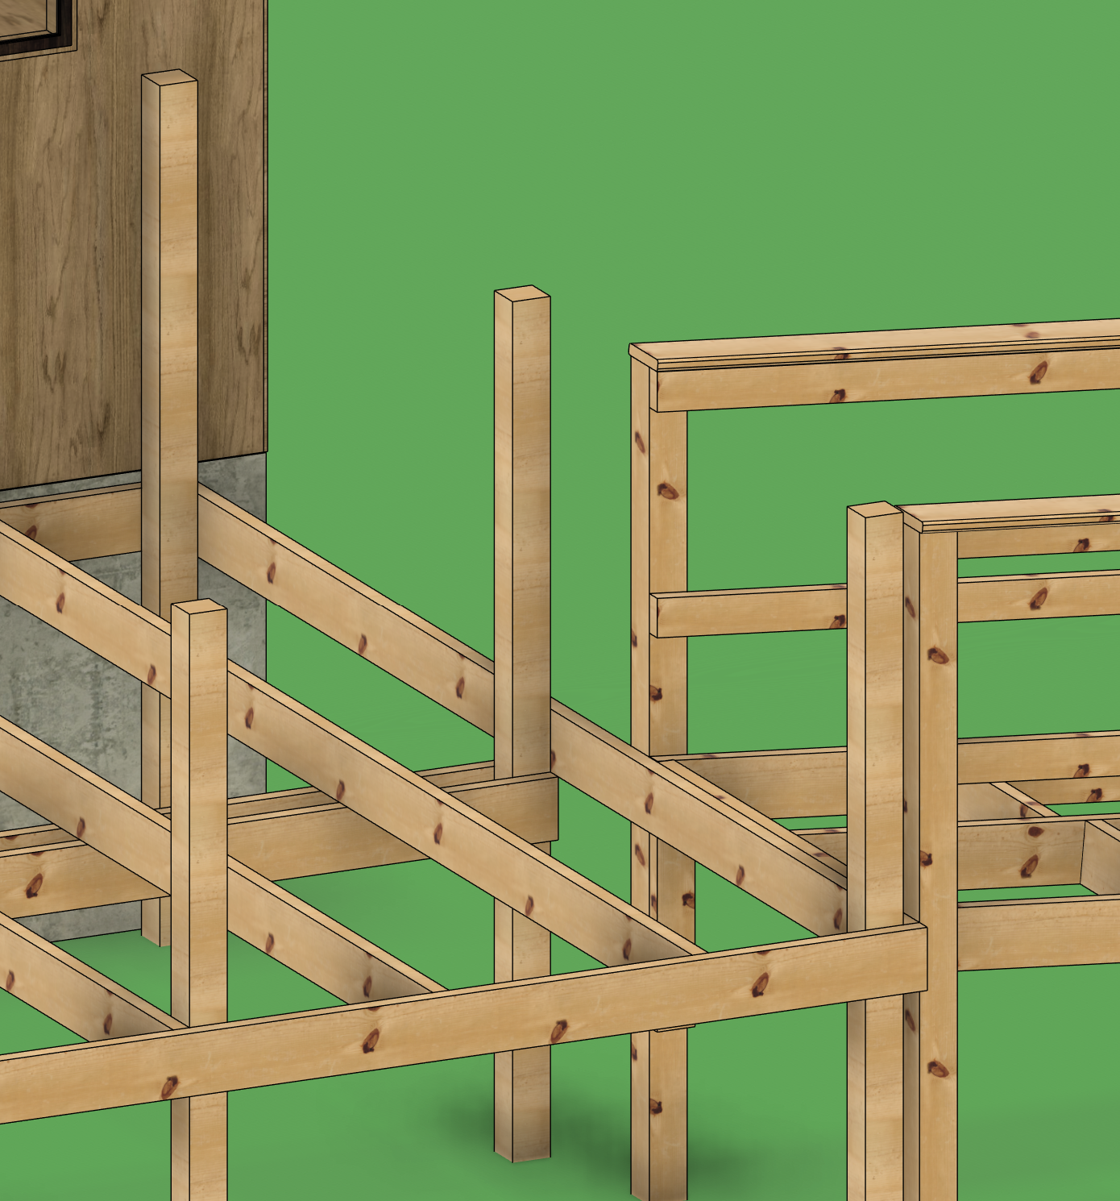
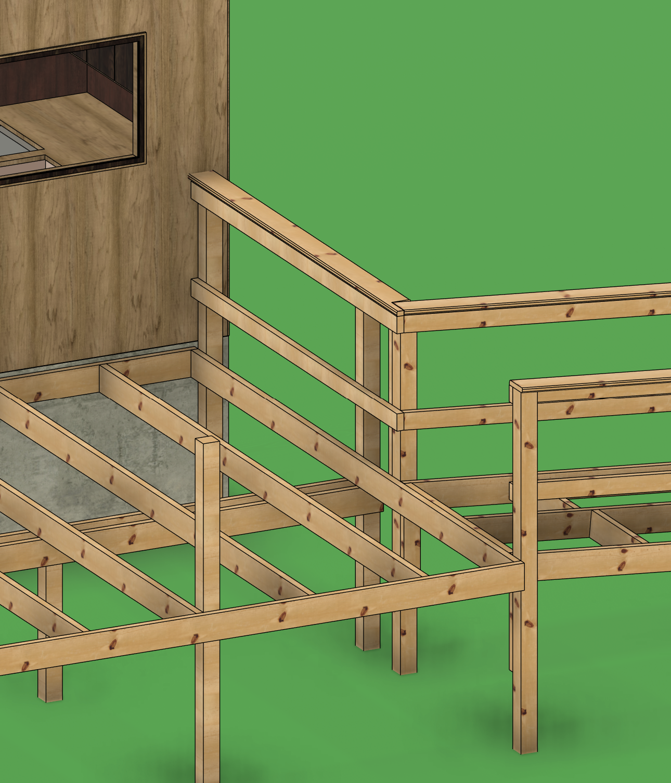
The Deck - Design – Adding a Ramp
Adding a Ramp
If a ramp is being added you must move all the posts on that side to accommodate this, in order for the handrails to work
Shown in the first picture is why the post need to move
Shown in the bottom picture, the post moved back to accommodate the ramp, this deck had a beam under it and its was also moved
To see how to do handrails ramp to deck connection
Turn to "fuie"

Slide 32
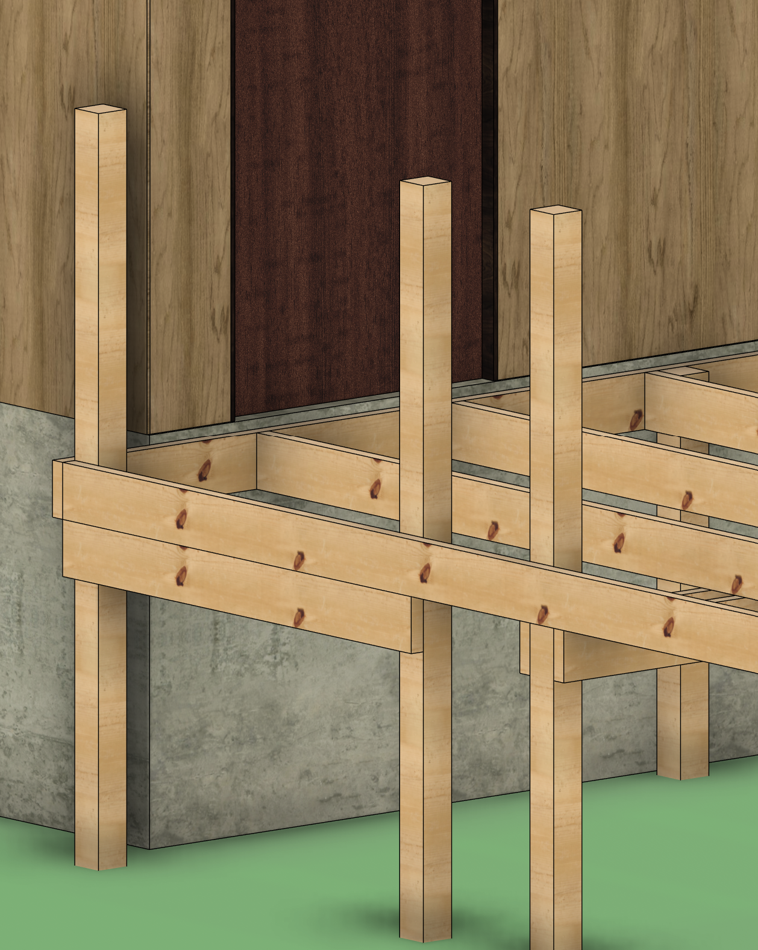
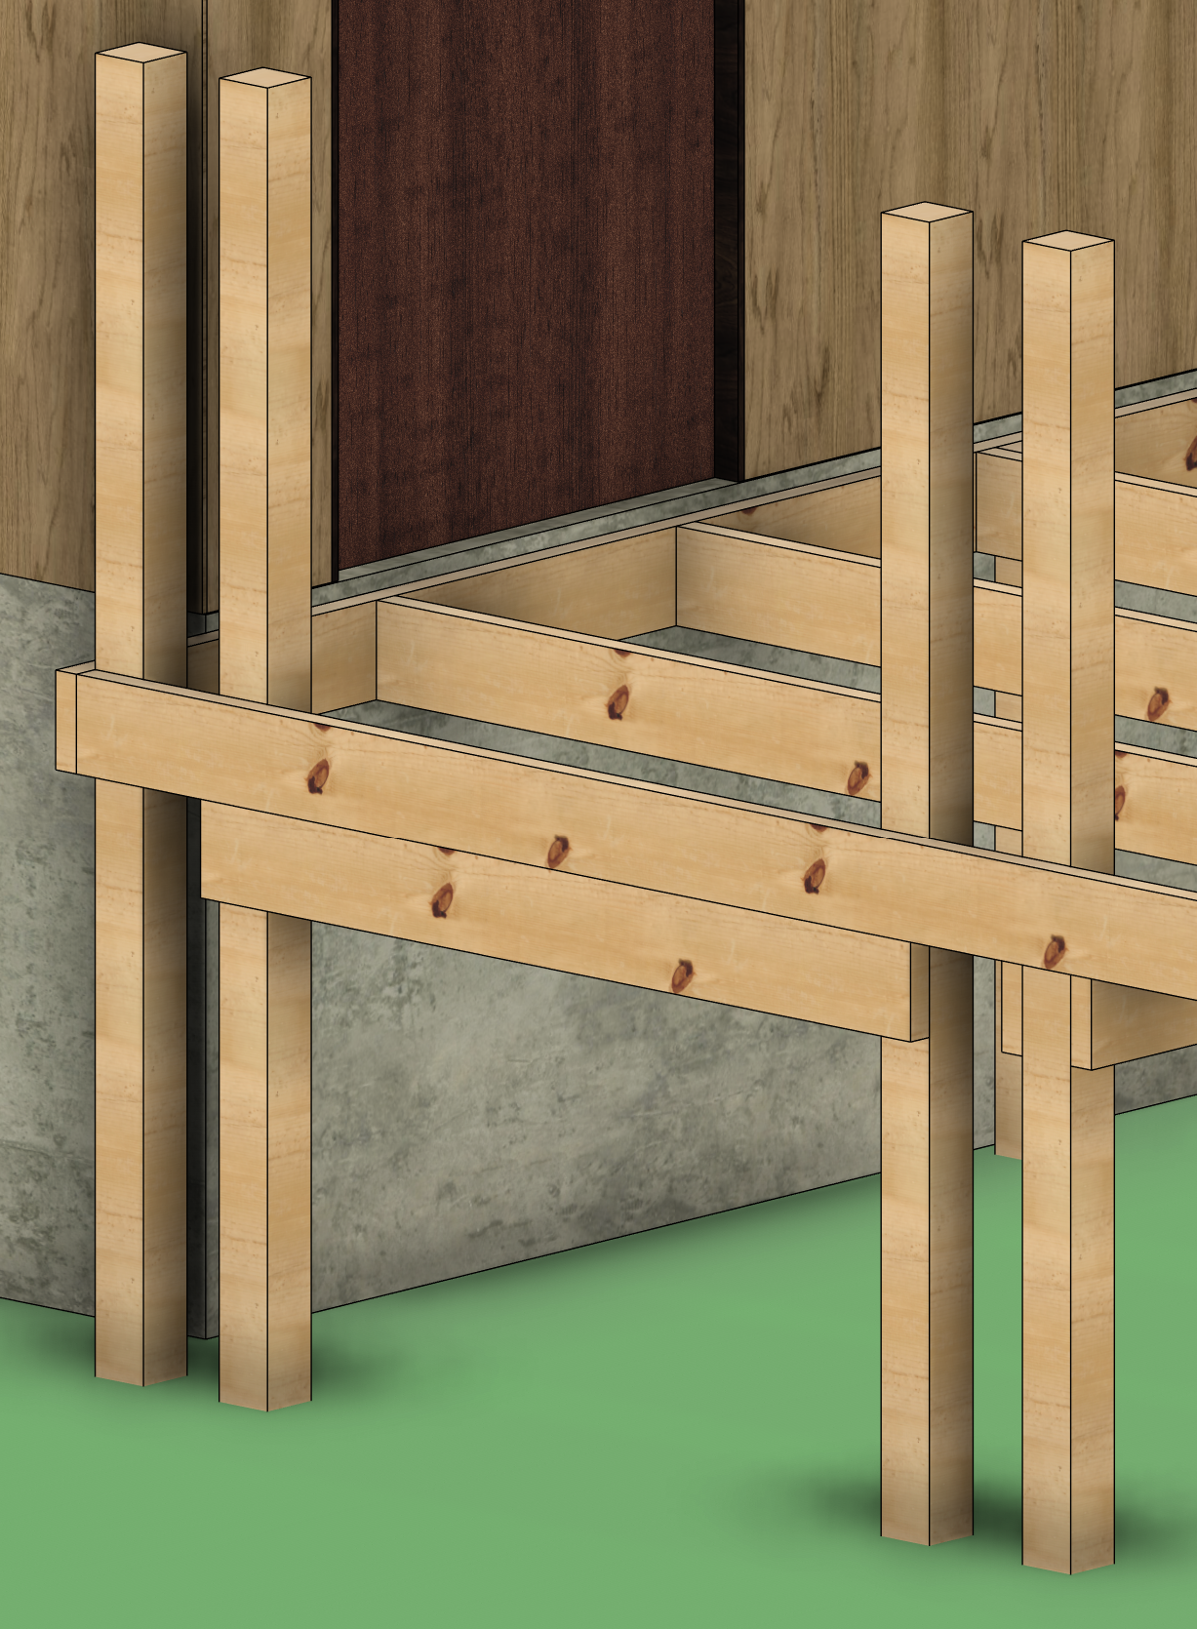
The Deck - Design – Adding Stairs
Adding Stairs
If a stairs are being added you must only consider where to add the posts
The width of stair should be from 36-48 inches
The posts are set inside the box because a backing board is added and we use stringer straps to attach the stringers
Majority of the time the stairs will “share” one of the corner posts, shown in the bottom picture is two dedicated posts for the stairs
Also see ending of posts considerations to fully think through your design
Turn to "fuie"

Slide 33
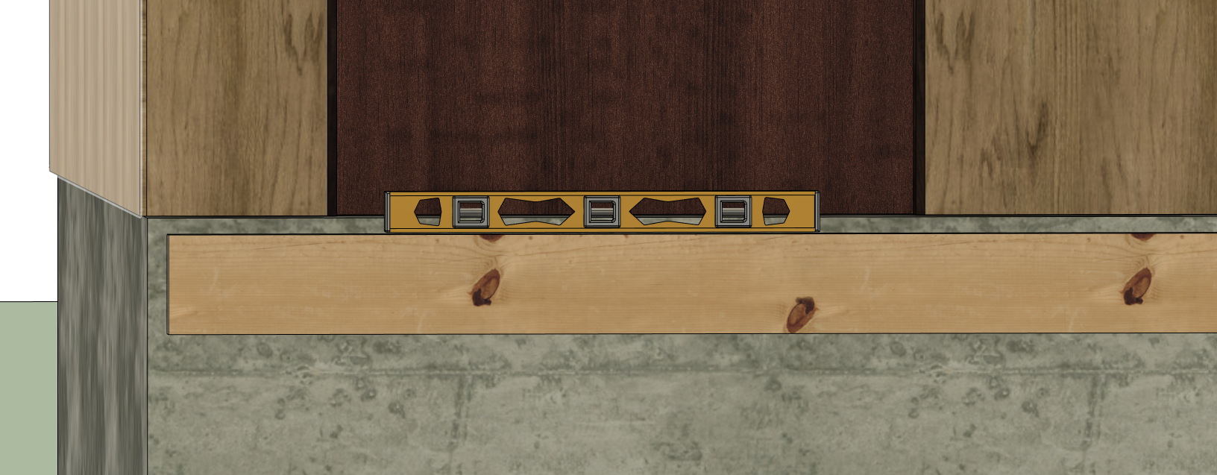
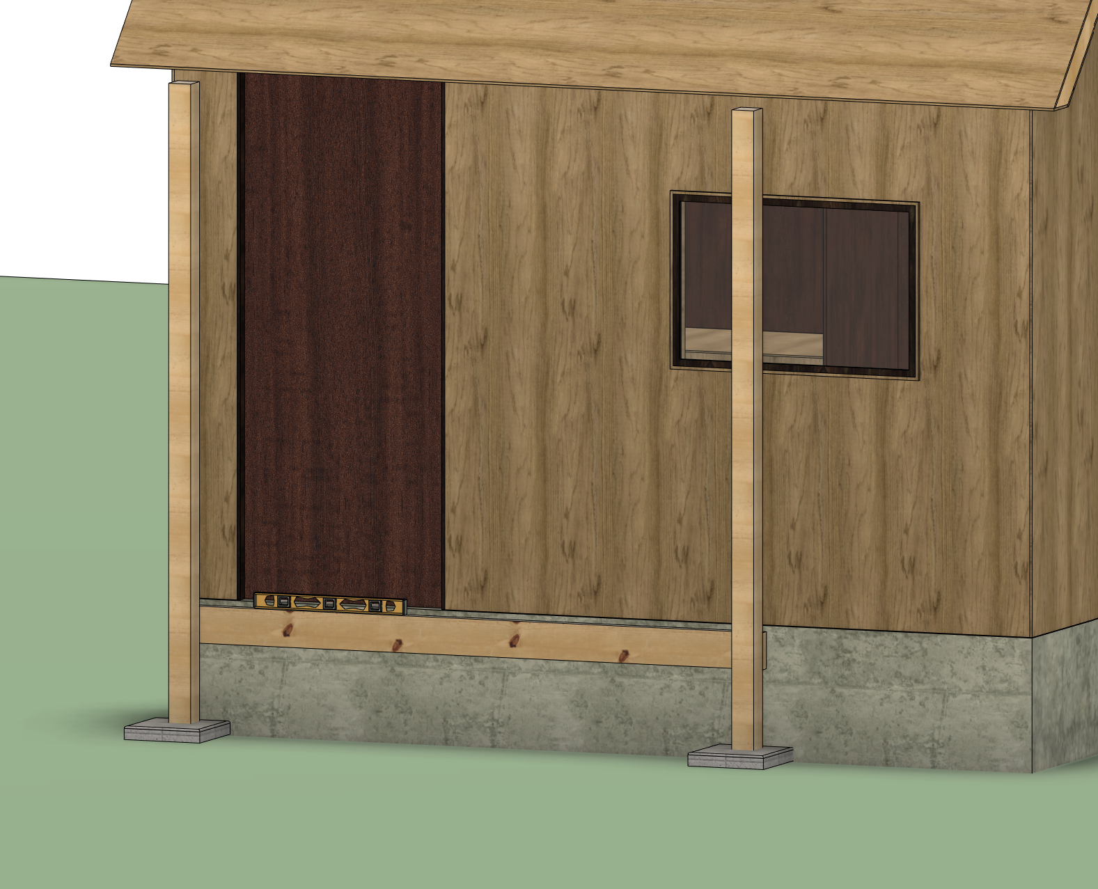
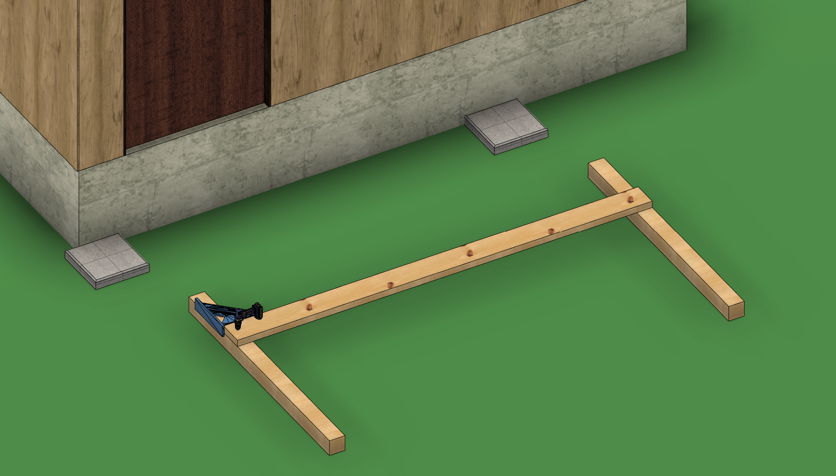
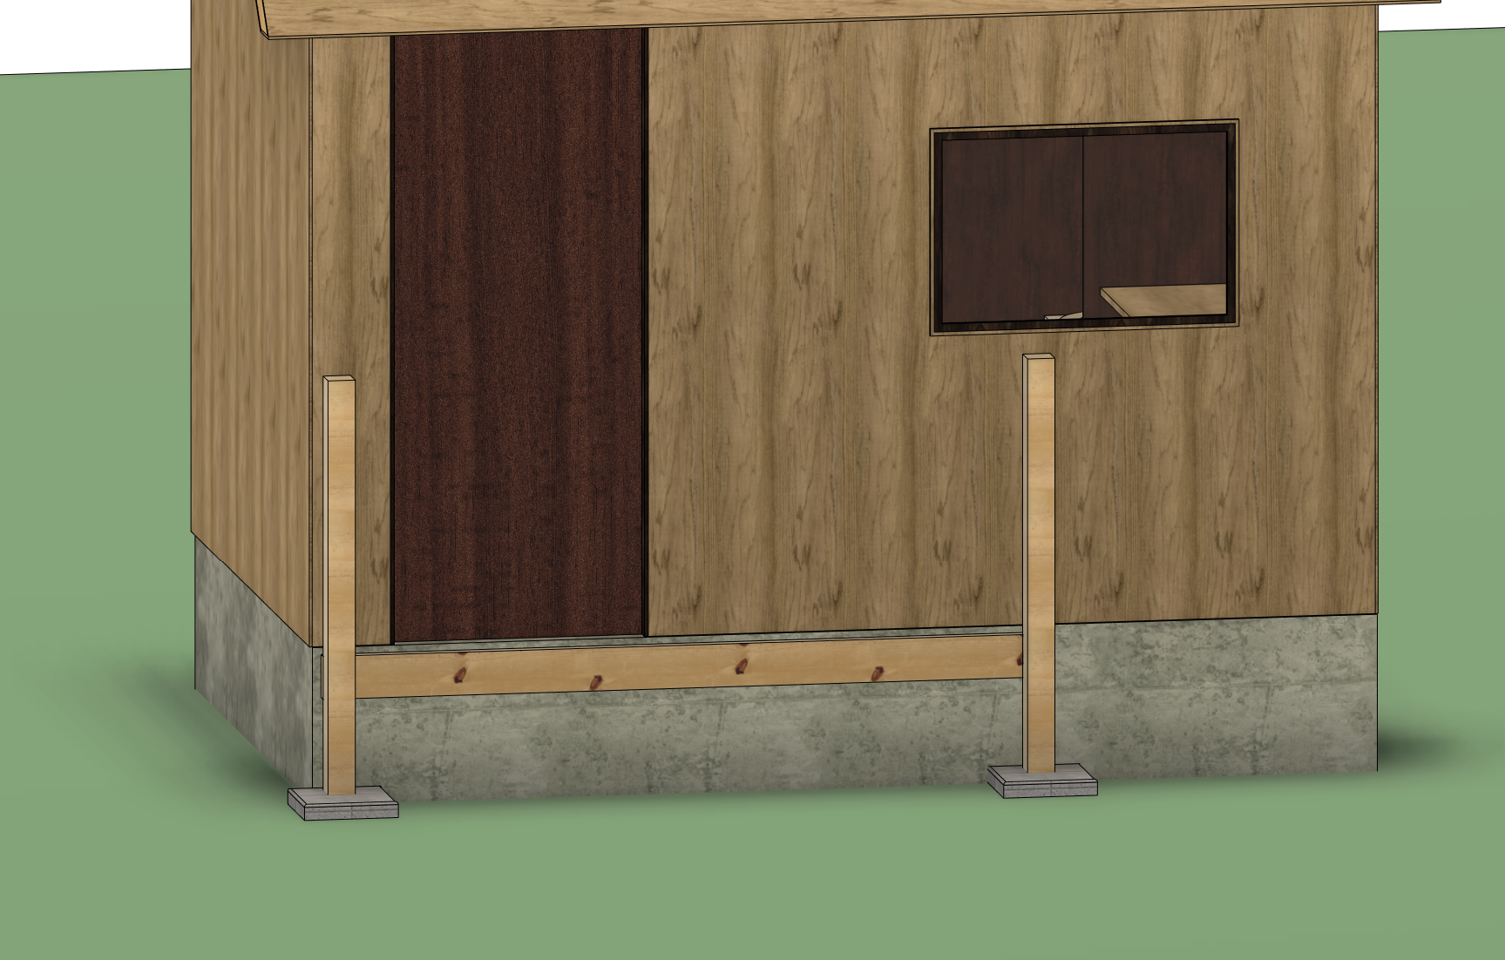
The Deck - Built in Place Frame - 1
Built in Place
Step 1
Grab the board that runs with the house, cut 3 inches off. Hold and level this board 5/4 under the door.
Step 2
Level the post with their correct ending and mark 36 inches from the bottom of the first board. Don’t screw anything together
Step 3
Cut the Posts flat on a miter saw, on the 36-inch mark.
Step 4
Assemble Frame on the ground might be the most effective way to screw in the screws. Use two 3in deck screw and a structural screw.
Step 1
1.5-inch gap
Step 2
Step 3&4
For instruction on how to level a post​
Turn to “fuie"

Slide 34
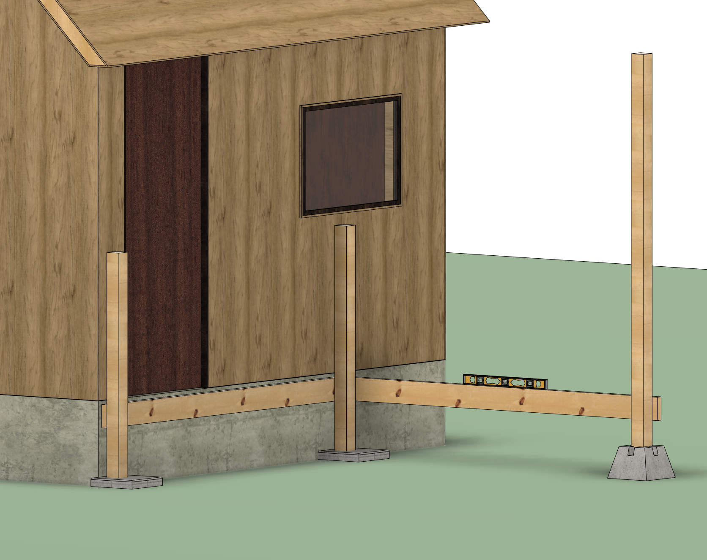
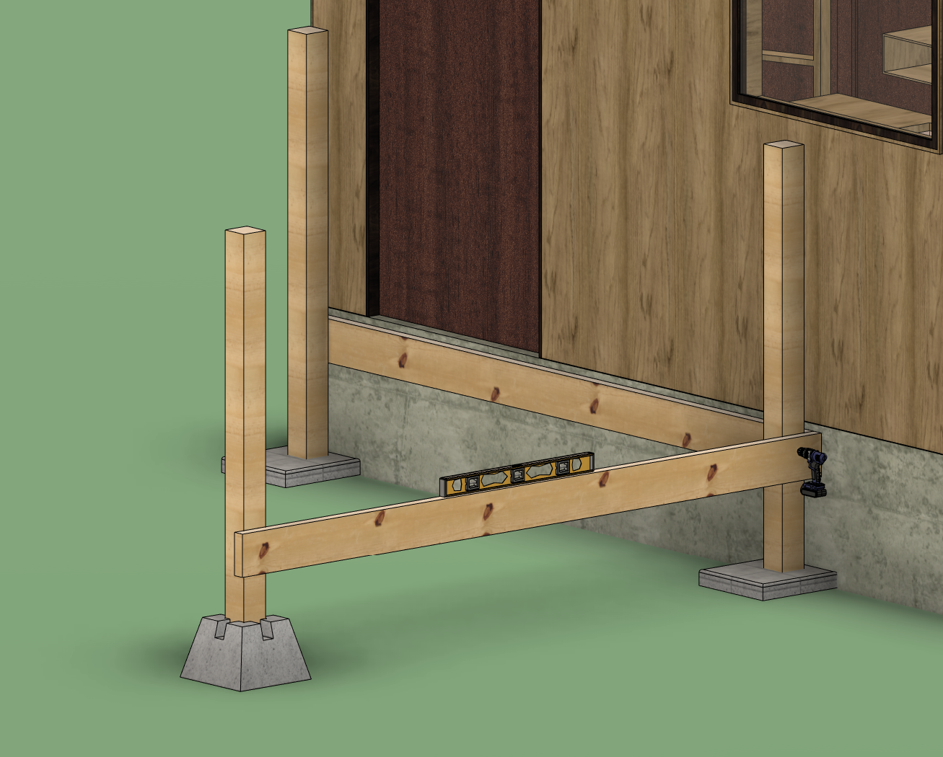
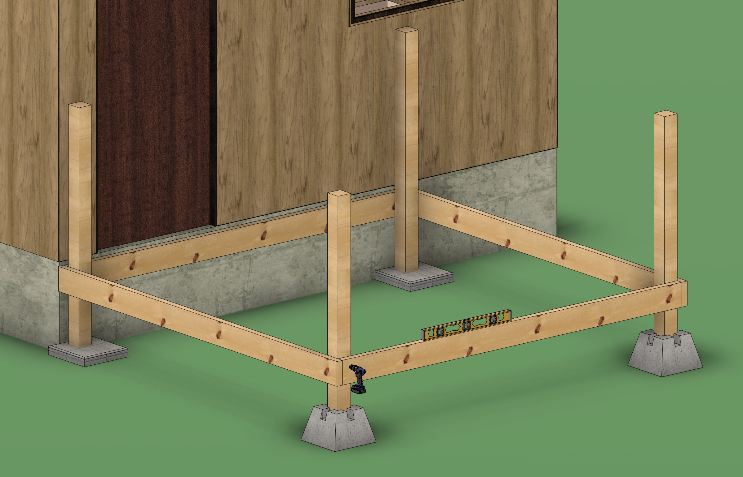
The Deck - Built in Place Frame - 2
Step 5
Get a board of the opposite size, length/width. Line up with one side of existing frame. Level Board
Step 6
Level the post with the correct ending and mark 36 inches from the bottom of the first board. Don’t screw anything together
Step 7
Cut the Posts flat, on the 36-inch mark.
Step 8
Assemble Frame leaving 1.5 inches of space from the end.
Step 9
Repeat steps 5-9 for other side
Step 10
Add another board with 3 inches cut off to the back
1.5 inch overlap
No overlap
Step 5&6
1.5 inch
overlap
Step 7&8
Step 9&10

Slide 35

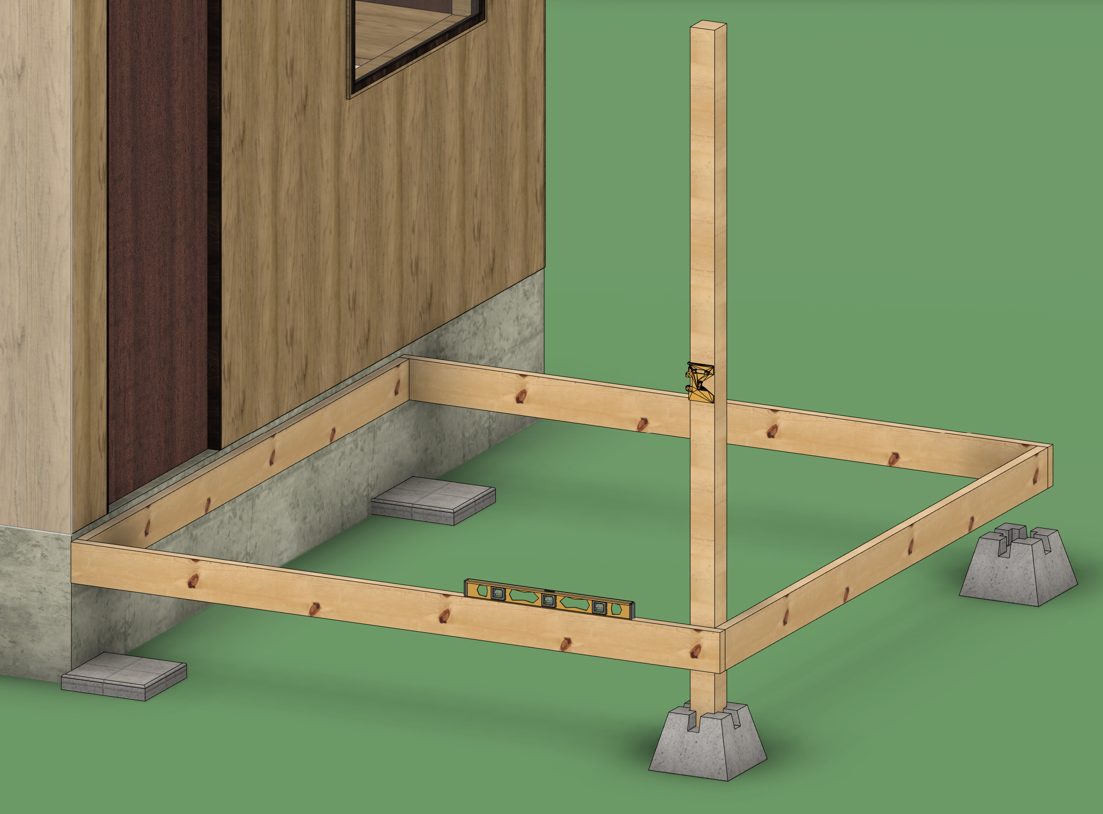
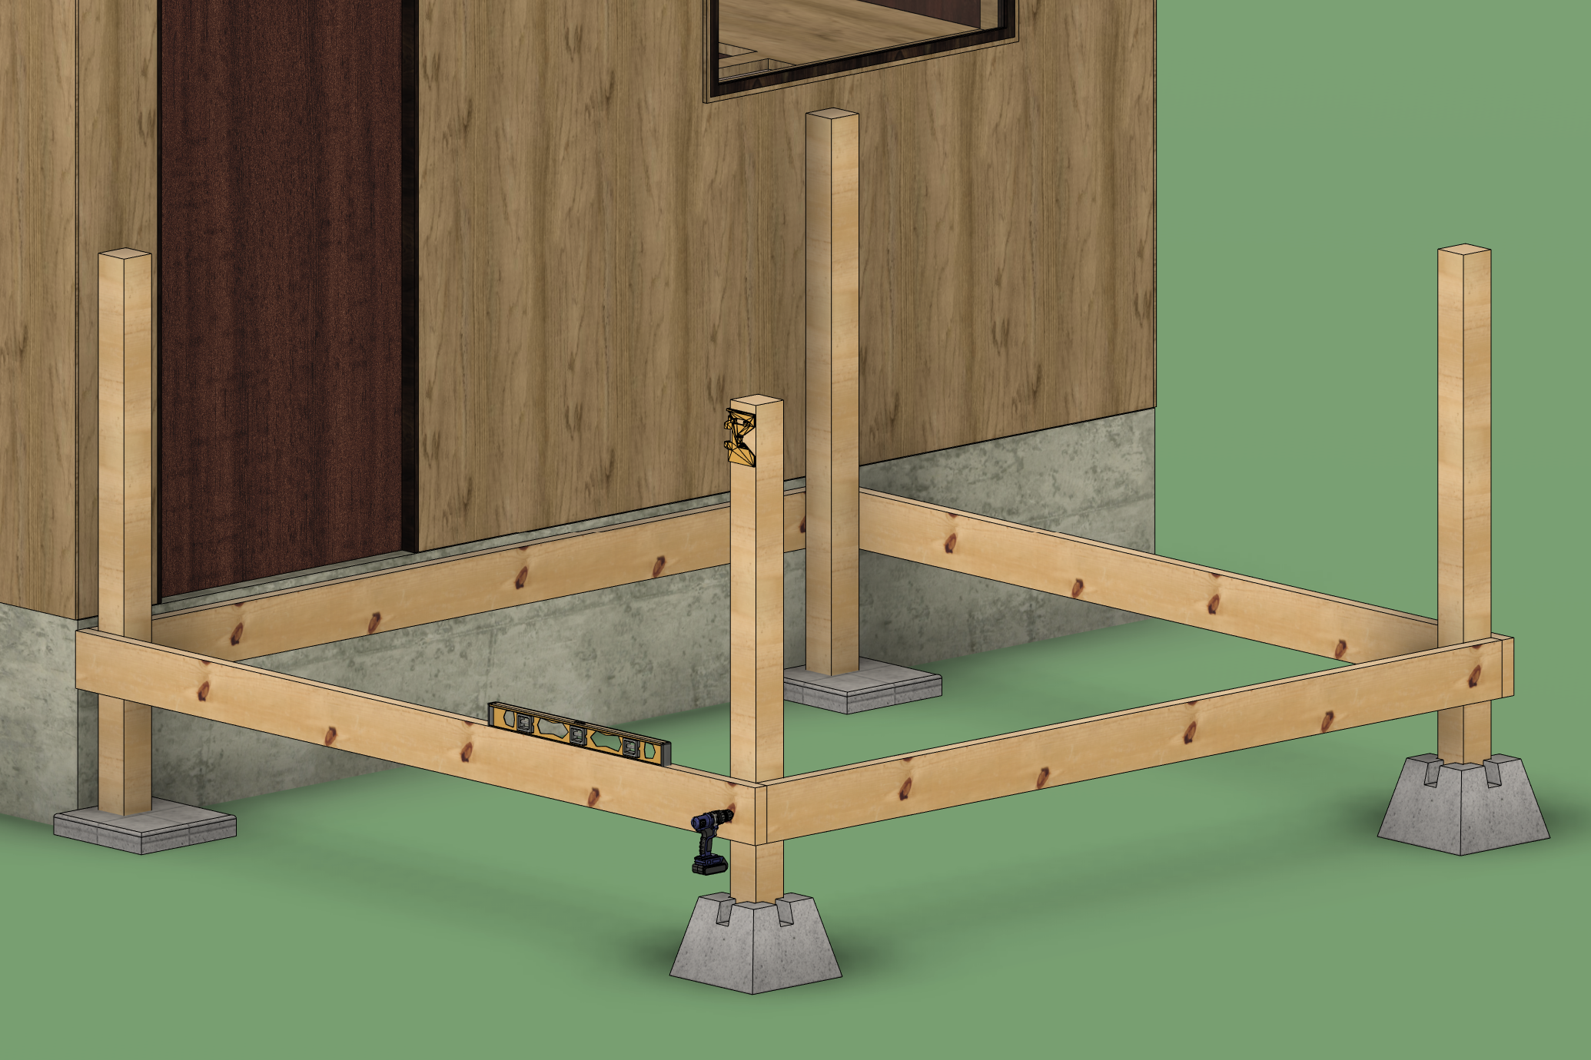
The Deck - Built Frame First
Frame First
Step 1:
Cut either the length or width boards by 3 inches.
Step 2:
Lay out and square each corner. Assemble with three 3in deck screws.
Step 3:
Move frame into place and mark out where the posts will go.
Step 4:
Hold frame level, keeping 5/4-inch gap from the threshold. Don’t screw anything together
Step 5:
Mark 36 inches up from the top of the frame
Step 6:
Cut posts on the chop saw
Step 7:
Re-Level Frame and attach posts
3 inches shorter
Full length
Full length
Step 1&2
Step 3-5
Step 6&7

Slide 36
The Deck - Cleats
Frame First

Slide 37
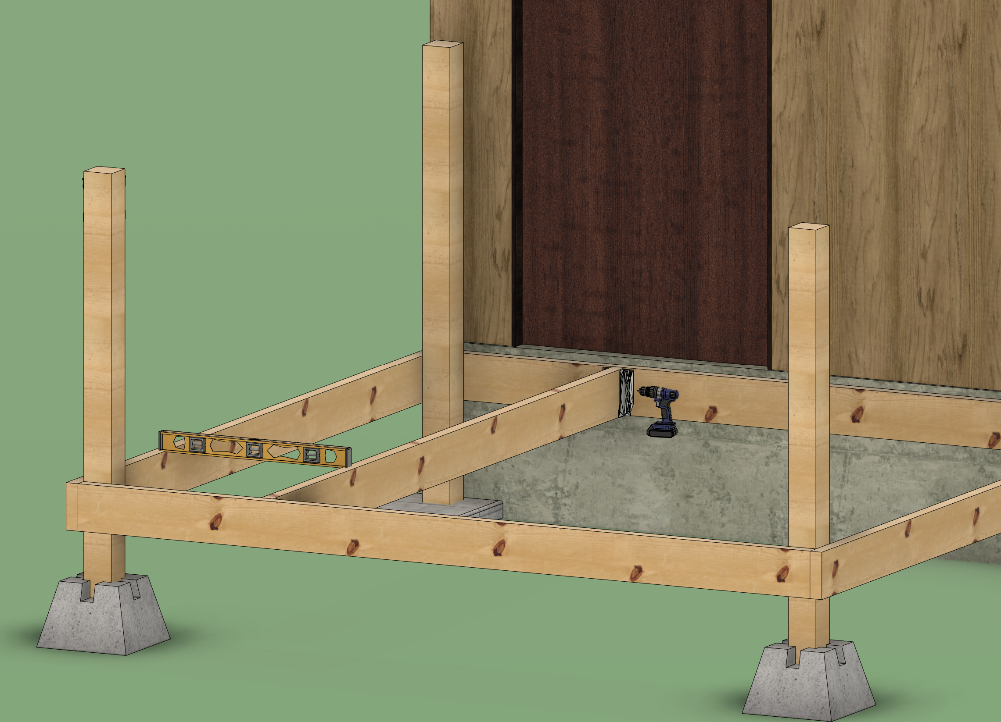
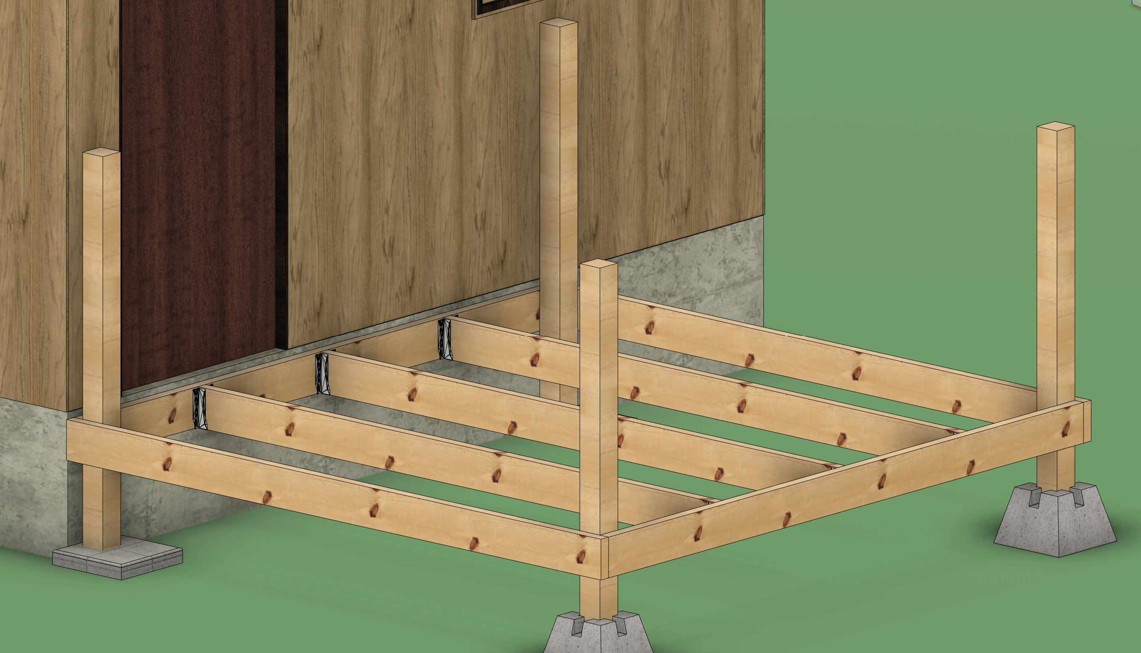
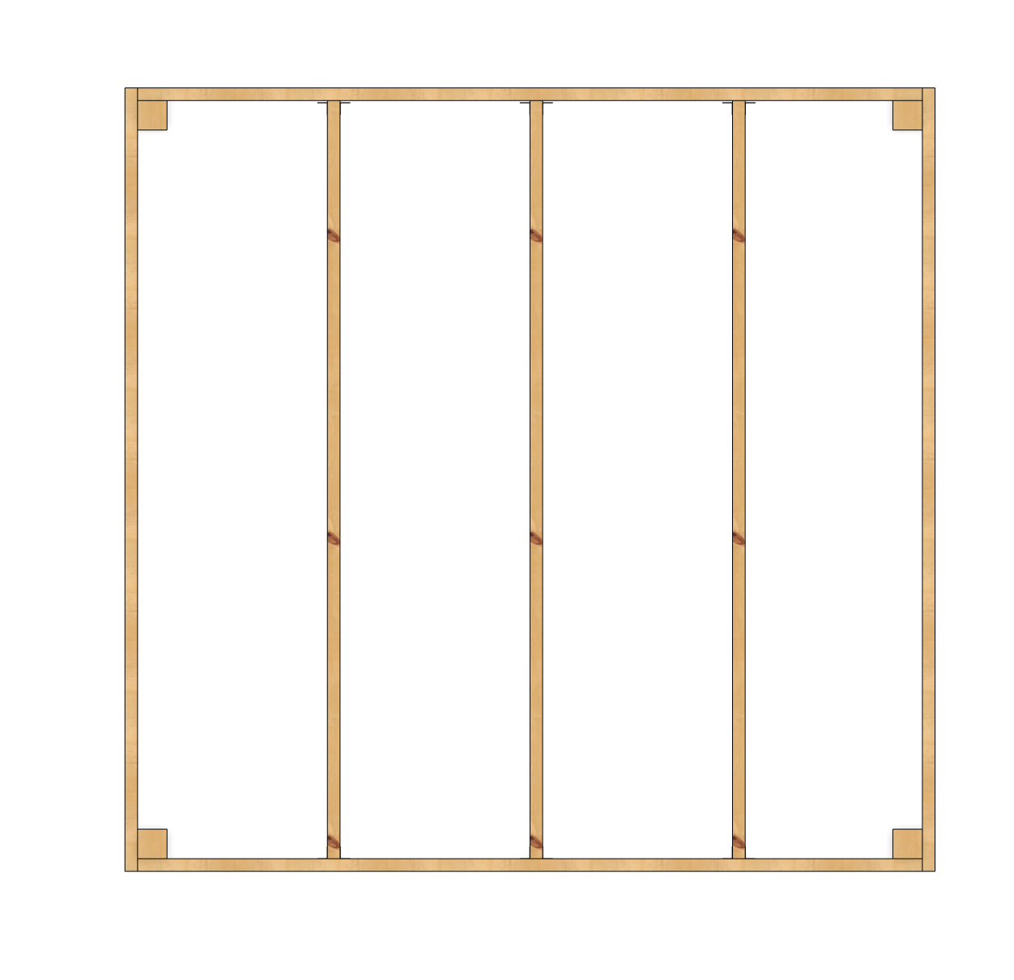
The Deck - Joists
Note
Most decks will have their joists running the shorter direction and will be decked the long direction.
Adding Joists
Make sure you have added other posts needed on your deck
Step 1:
Mark the spacing on the
Boards.
Formluas
Step 2:
Attach 2x6 joists on the markings. Use Joist Hangers. Make sure the joist are level with the frame
Step 3
Repeat step 2 until joist are done
2 ft on center spacing
To Figure out how to use a joist hanger turn to page “FJOE”

Slide 38
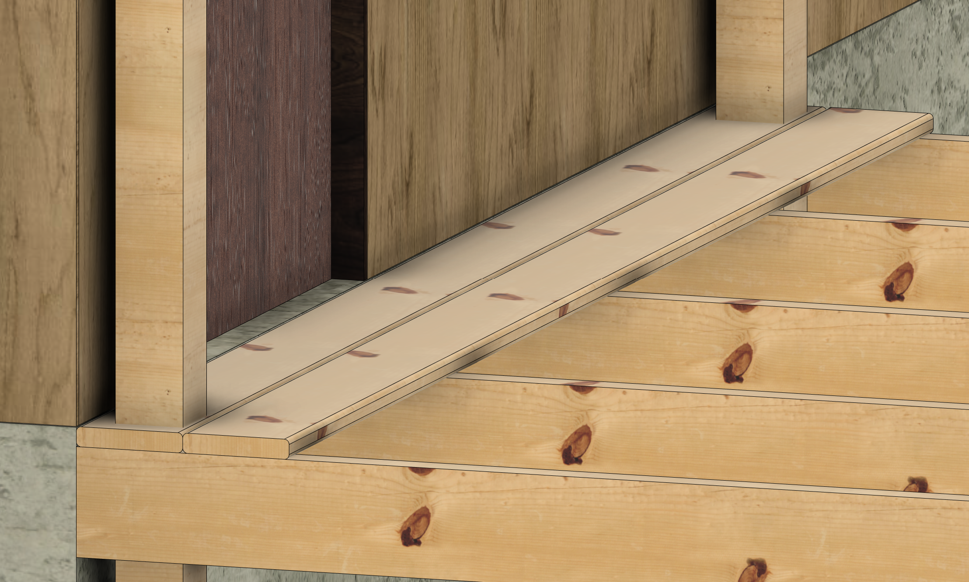
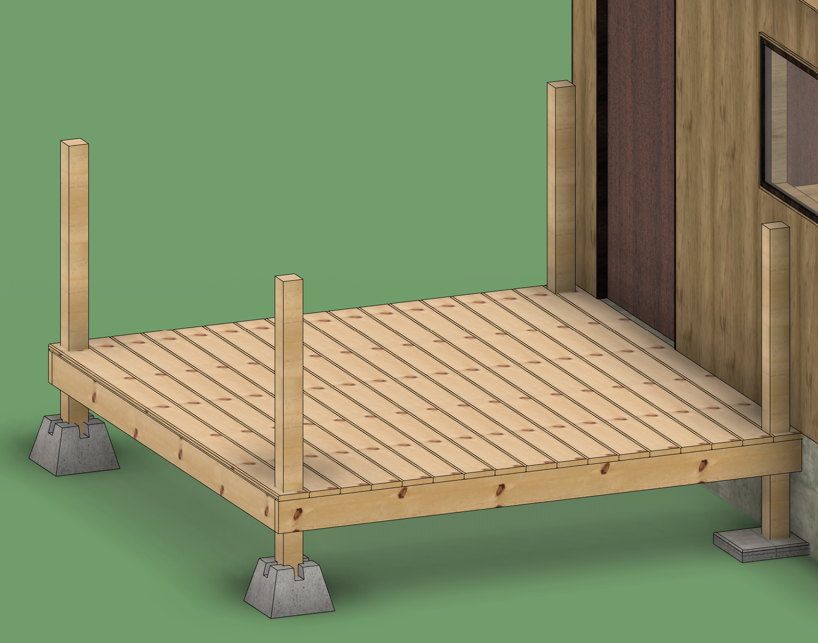
The Deck - Decking
Decking
Make sure you have
added other posts
needed on your deck
Step 1
Cut a deck board to the direction you are decking, you deck the opposite way the joist run
Step 2
Place the board and use 2 screws per joist
Step 3
Repeat until done
Note 1
With posts set inside the deck, you will have to cut those out in the deck boards
Note 2
You may have to rip across the length of a deck board in order
To Figure out how to cut out weird shapes in deck boards
Turn to“FJOE”
Pro Tip
If the deck board has a bow where it dose it is not flush with the pervious board. Screw in one side first and push on the board to help fix the bow before you screw in the next board

Slide 39
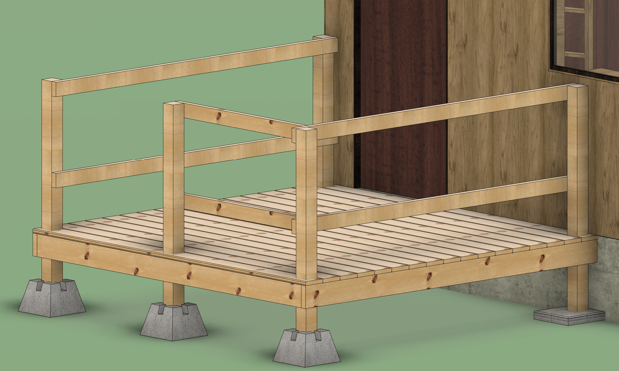
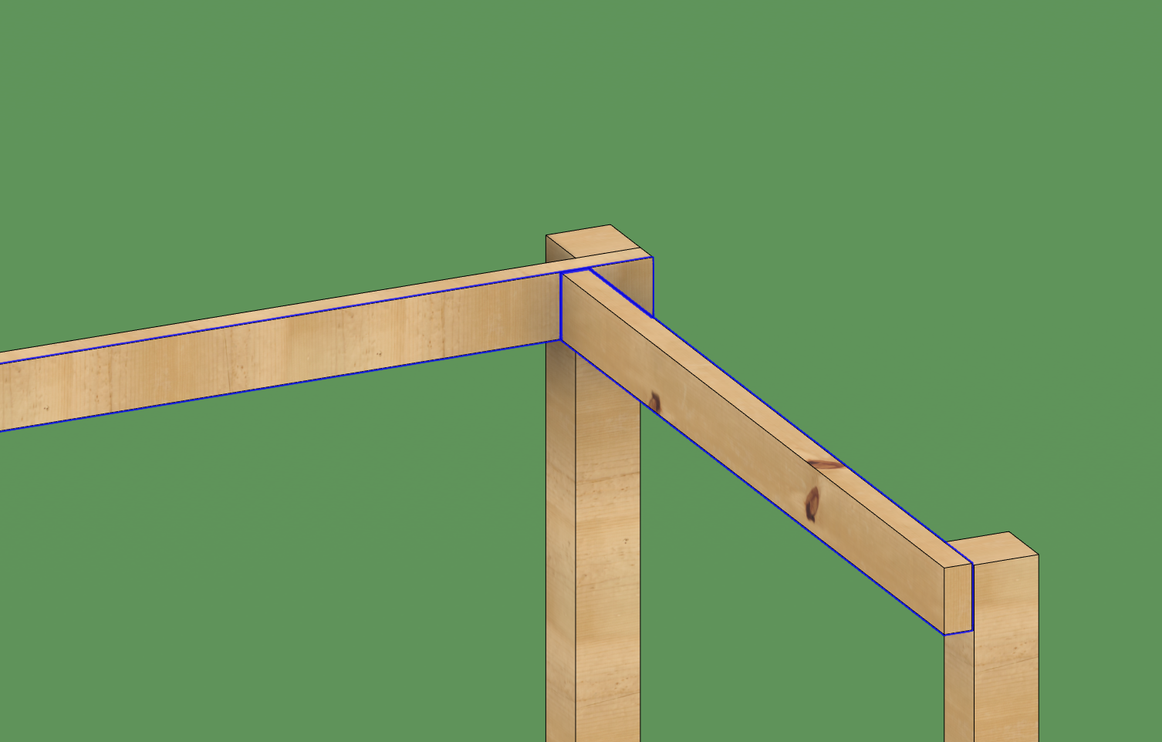
The Deck - Hand Rails Top and Middle rails
Handrails
Step 1
Measure from post to post on the inside of the deck.
Step 2
Cut a 2x4 to the measurement, and attach, see note 1
Step 3a
For the middle/kicker rail height, see note 2
Step 3b
For the top rail level with the topp post. Attach with two 3-inch screws
Note 2
If there is a ramp attached to the deck, you should match the kicker rail, using the same 8in blocks to set the height. If there is no ramp the middle/kicker rail can be placed per client's preference. Attach with two 3-inch screws
Note 1
Longer sections should have priority to connection to 4x4 posts. Short handrail sections being screwed in before. In some cases, you may need to screw two section together because the 4x4 post will block access.

Slide 40
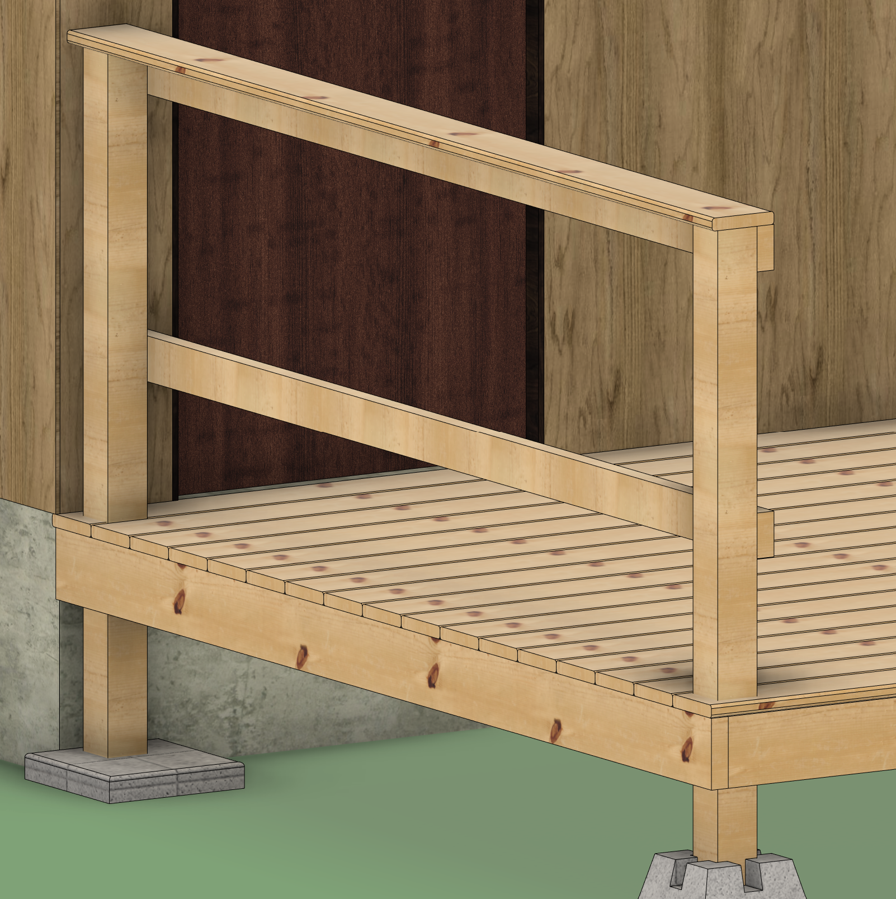
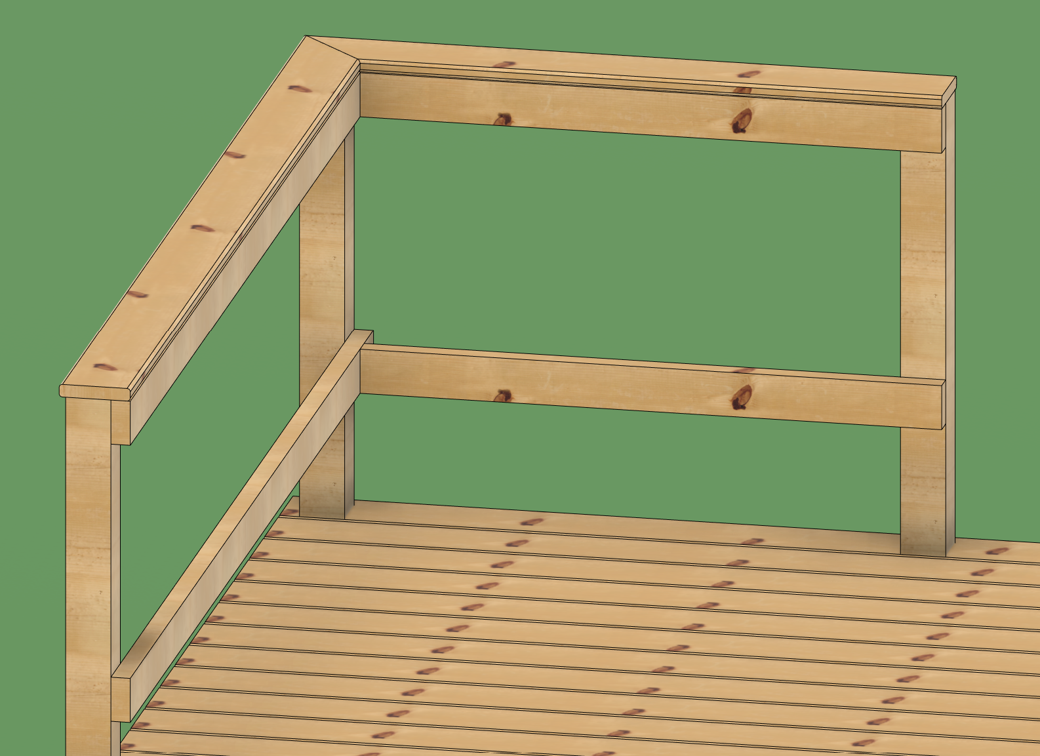
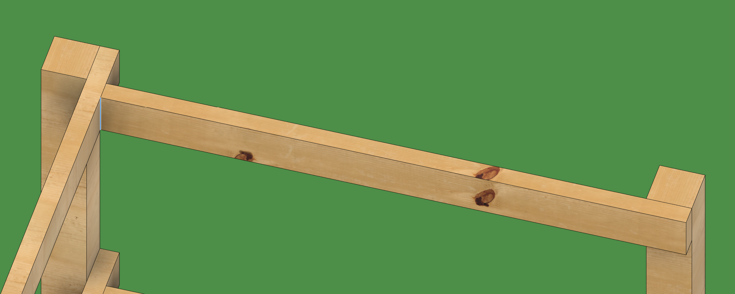
The Deck - Hand Rails top deck board
Top Board
Step 1
Measure from post to post on the top of the top 2x4
Step 2a
If there is no other top deck board connecting it should be cut flat
Step 2b
If the top board meets a corner, measure to the closest side (inner corner) and make a 45° miter cut angling outward.
Step 3
Attach with two 2 in deck screws, you can and should also add 2in deck screws along the length of the top board
Step 2a & 3
Step 2b & 3
Outward 45° angle
Inside corner measurement

Slide 41
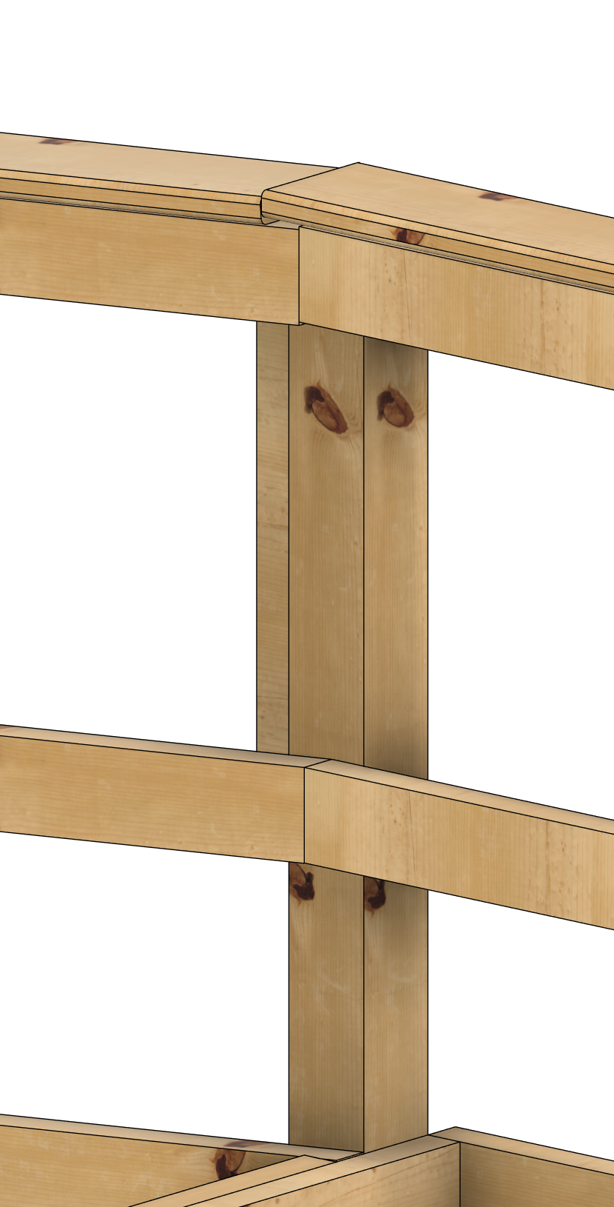
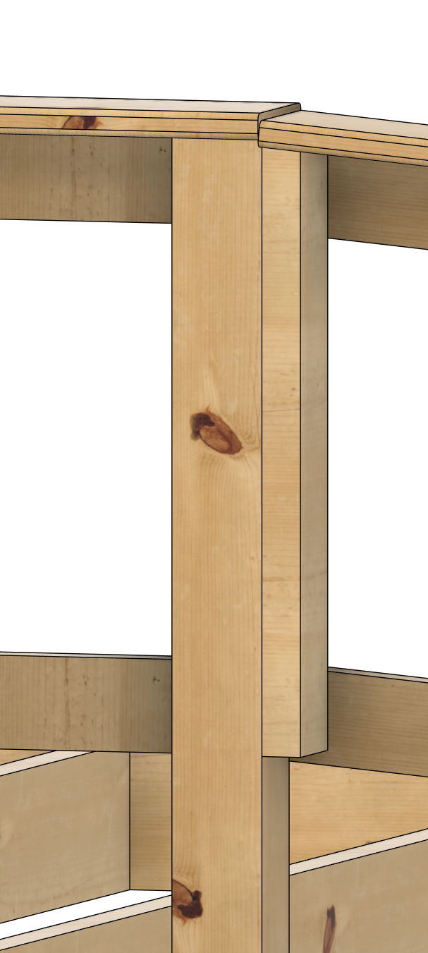
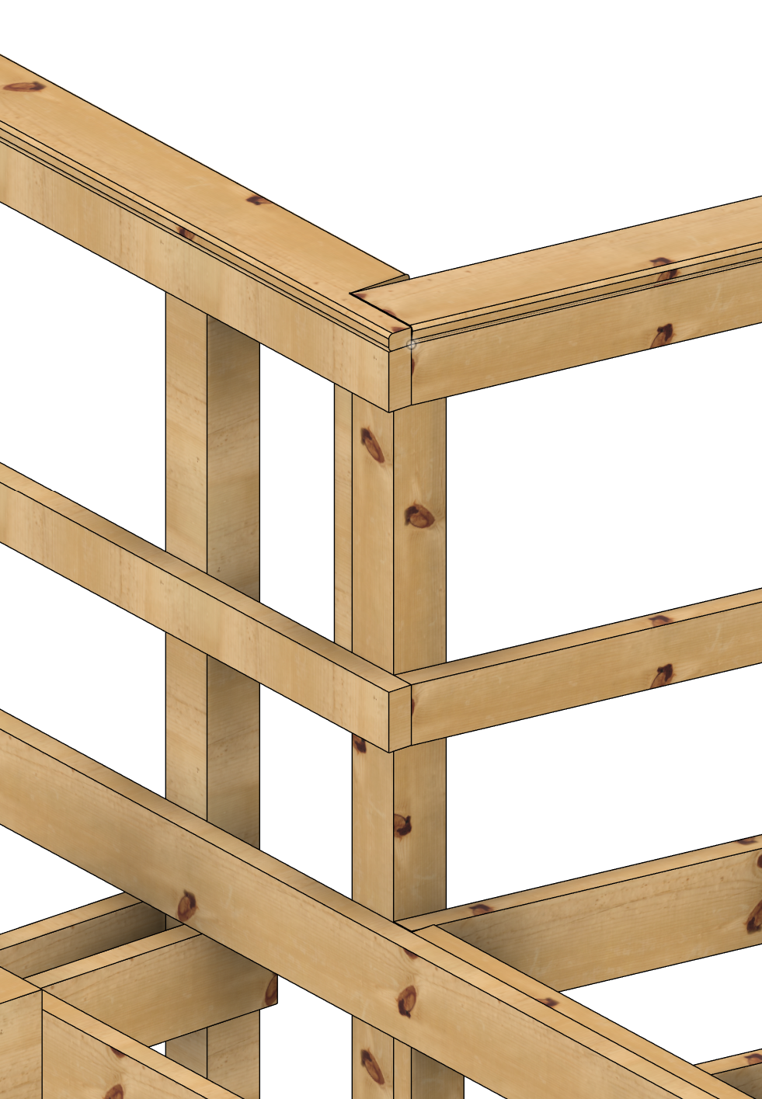
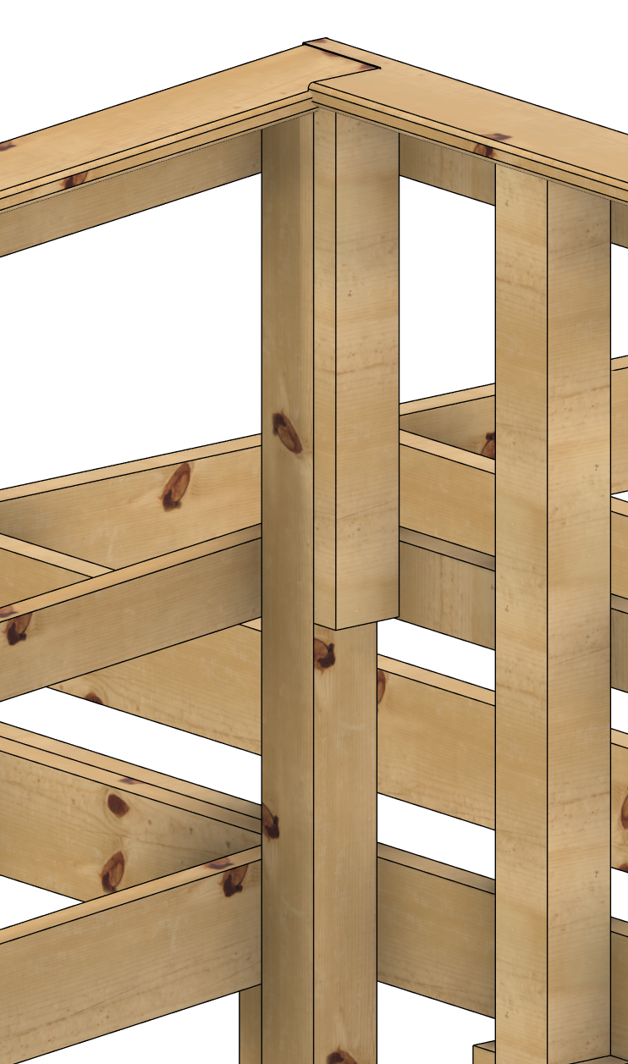
The Deck - Hand Rails when RAMP
Deck to Ramp hand rails
Top set:
Recommended connection type for parallel connections
Bottom set:
Recommended connection type for perpendicular connections
Both connections will need an extra 2x4 cleat, min length of 12 inches or to the bottom of the middle rail
Front
Back
Front
Back

Slide 42
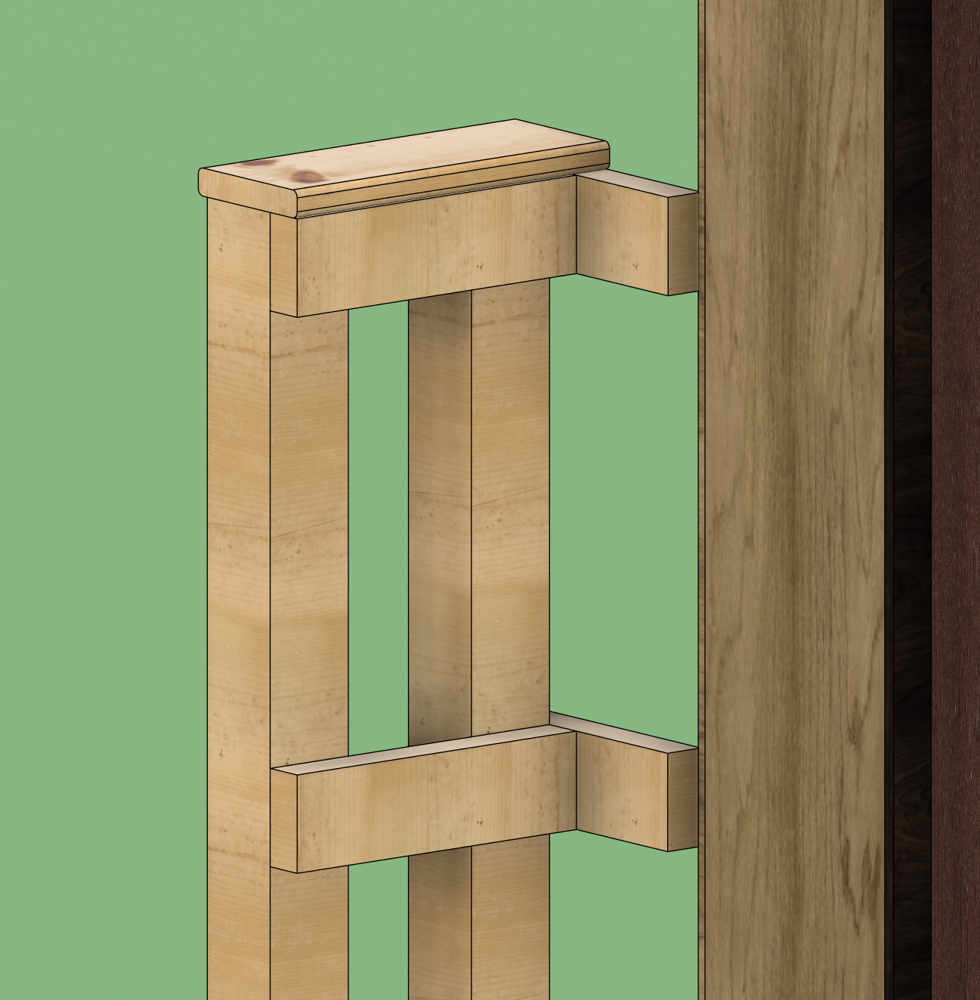
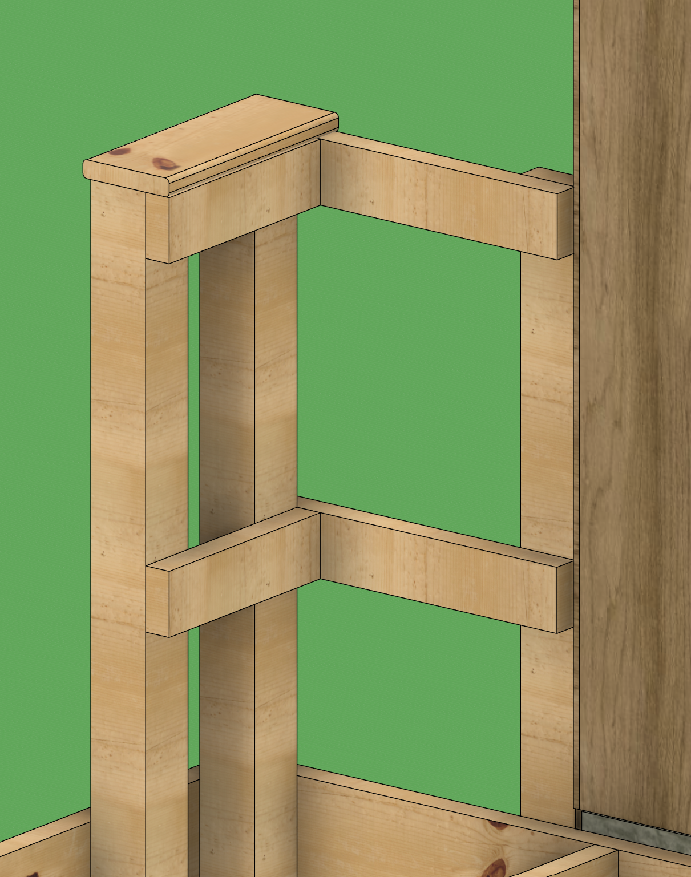
The Deck - Hand Rails when WEIRD
Other Hand Rails
Free standing short distances
Distance under 1 foot that are attached to a 4x4 posts can be free standing
Free standing short distances
Distance over 1 foot but under 2 ft that should have a 2x4 or 4x4 supporting it
If using a 2x4 for support the max span it can support is 2ft and can not have a top handrail board.
Do NOT attach anything to the client's house unless it has been explicitly allowed

Slide 43
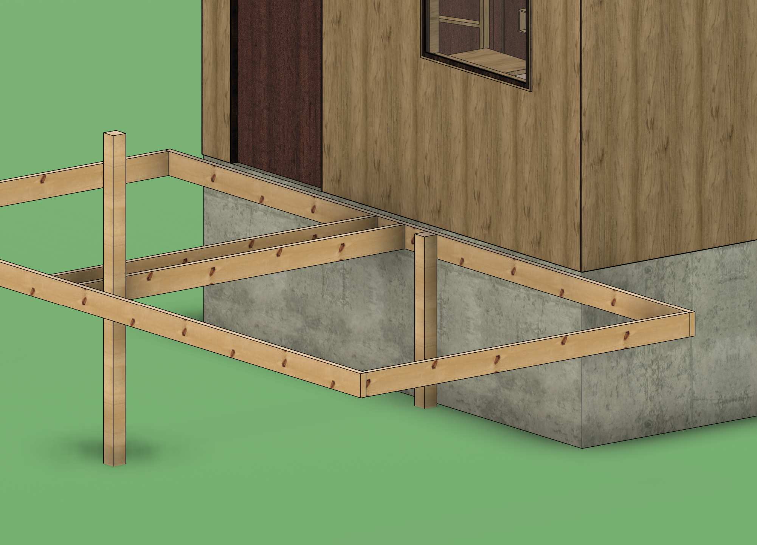
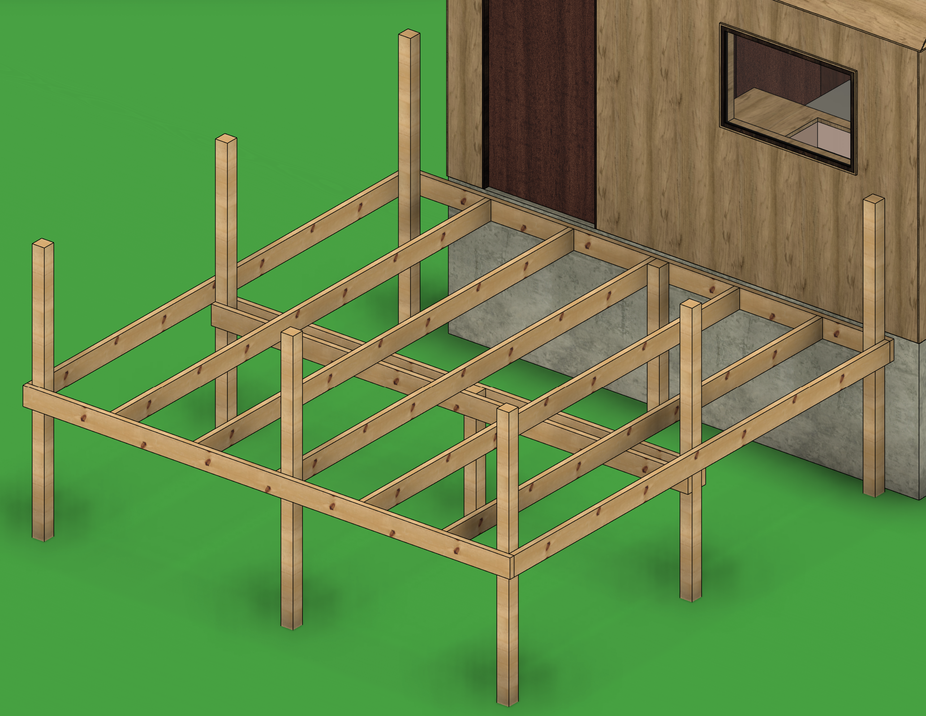
The Deck - Decks over 8ft
Decks over 8ft
Decks that have one direction over 8 ft
Since the joists are under 8ft, you only need to support the two sideboards with a 4x4 post. For a 16ft span this post has to be in the middle.
Decks that have joist over 8 ft
For decks with joist lengths over 8ft. A beam will need to be added. Adding 2 posts on the opposite side where you need the beam then running two 2x6s across. You may need to add a middle 4x4 for support to the beam if the beam is over 8ft. Attach with structural screws or long cleat with deck screws
8x16ft box shown, back post cut flush because there will be no handrail
12x12ft box shown, need extra support on every side of the frame. A beam is under the posts with another post supporting it halfway

Slide 44
The Stairs
Everyone favorite.
Materials needed
Varies Per Project
Tools needed
Chop saw
Circular Saw
Drill/Impact Driver
Post Level
4ft Level
Framing Square
  2 Brass Stair Gauges

Slide 45
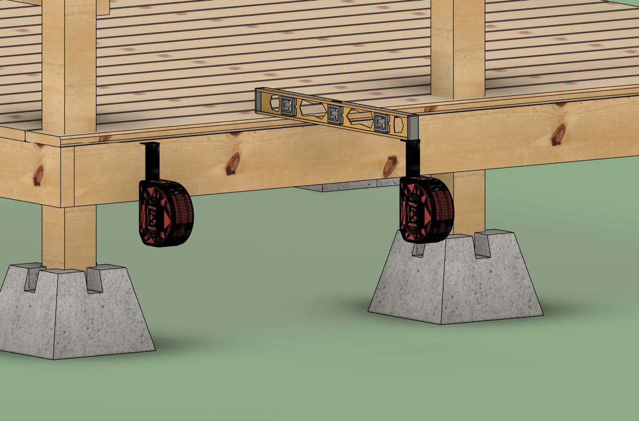
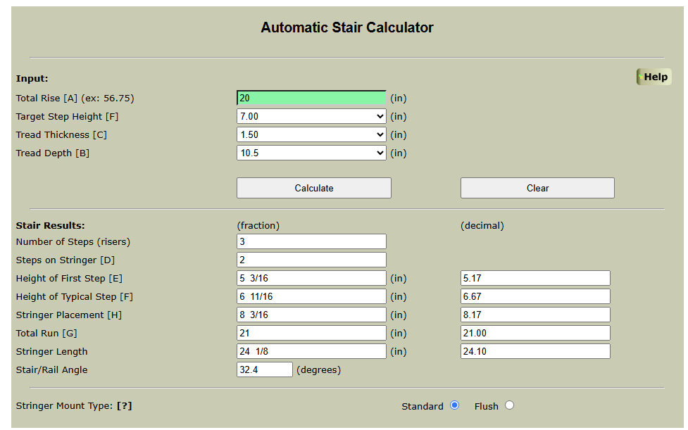
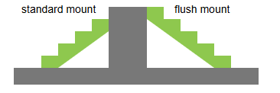
The Stairs – The Stringer 1
Marking stringers
Step 1
Measure the total drop/rise of the stairs. Account for any ground slope by using a 4ft level or a line level.
Step 2
Identify your variables:
Run (Tread Depth): 11 inches (using two 2x6 boards)
Tread Thickness: 1.5 inches
Rise: Unknown (to be calculated)
Enter these dimensions into an online stair calculator (https://mycarpentry.com/stair-calculator.html)
Note
In the majority of cases, we use standard mounting for stringers

Slide 46
The Stairs – The Stringer 2
Marking stringers
Step 3
Slide one brass nut onto the inside of the framing square and tighten it at the measurement for your rise. Slide the second brass nut at the measurement for your run
Step 4
Mark each step
Step 5
On the last step take width of one tread board off to make every step even.

Slide 47
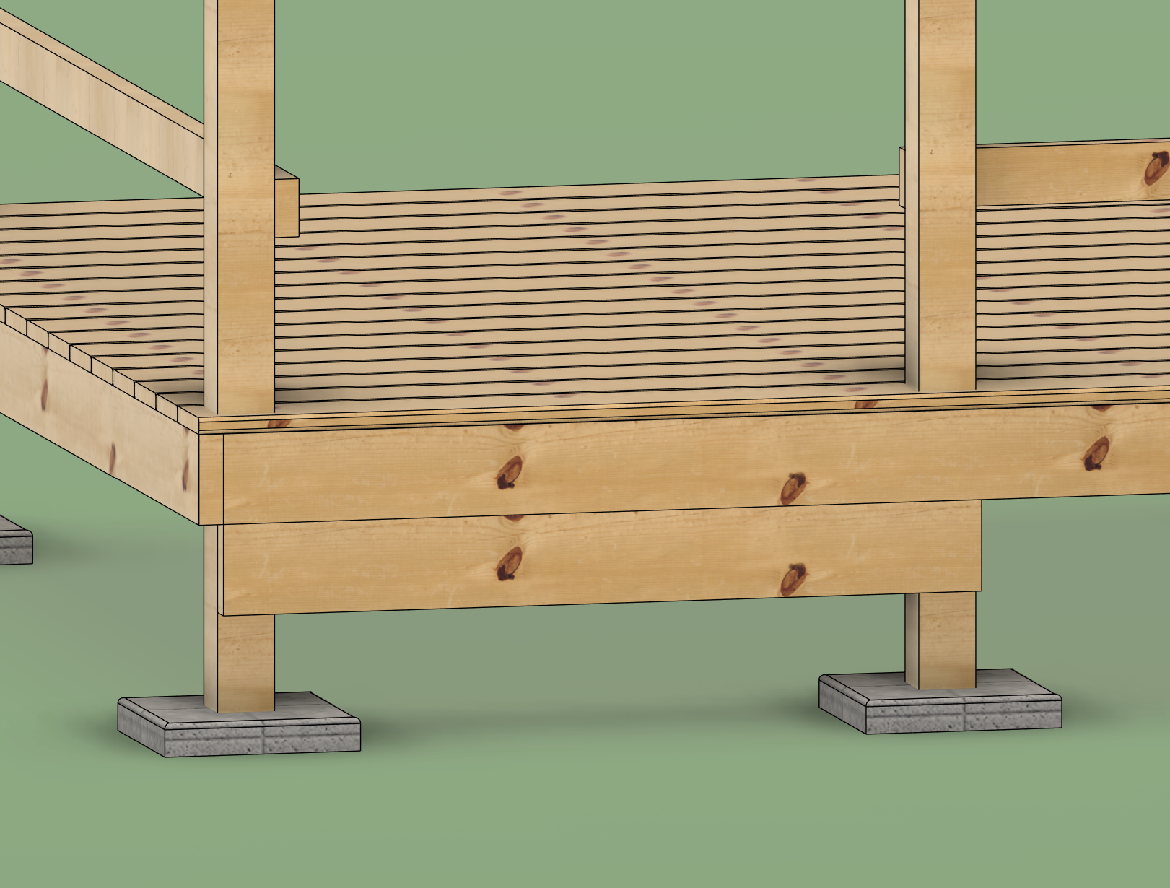
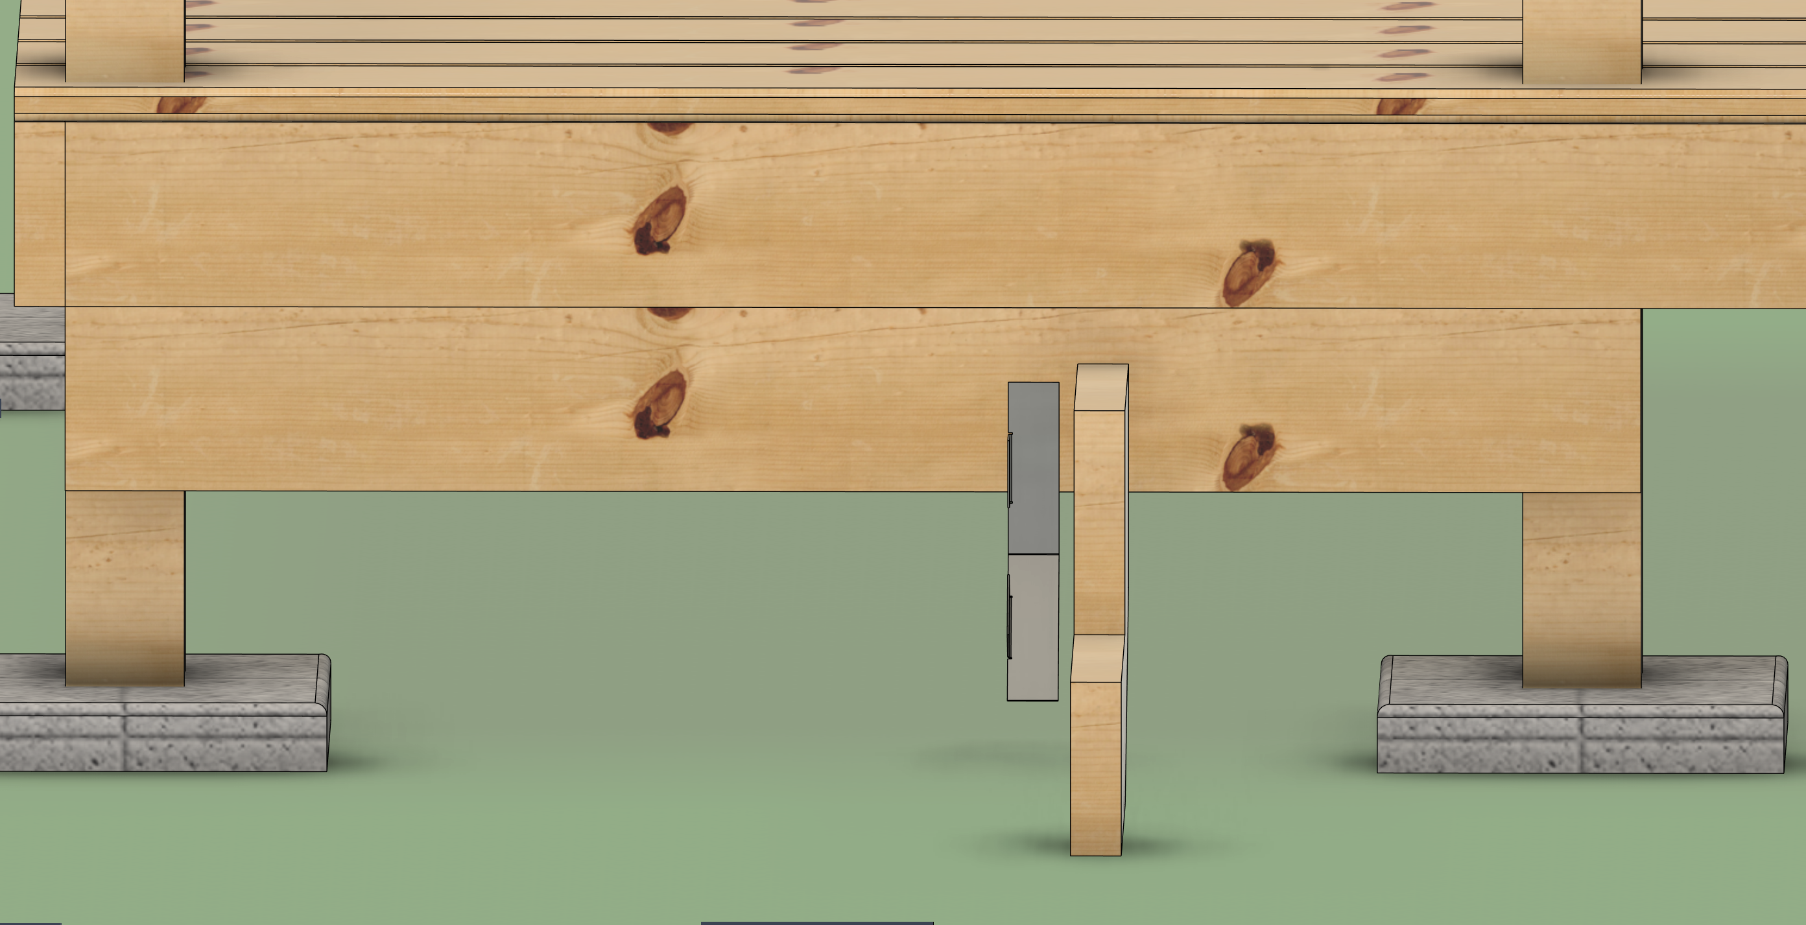
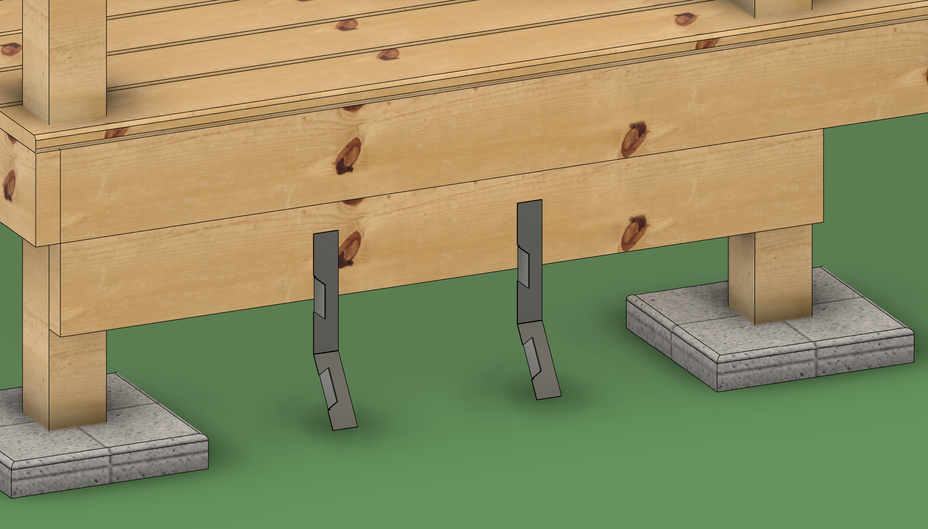
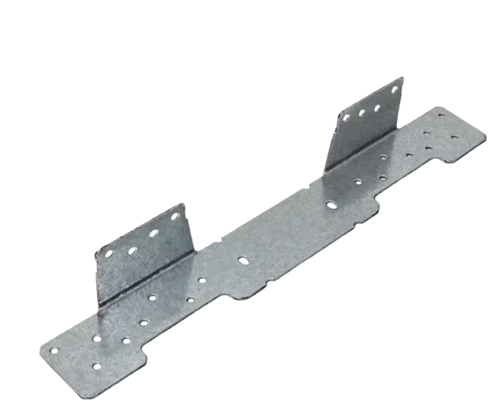
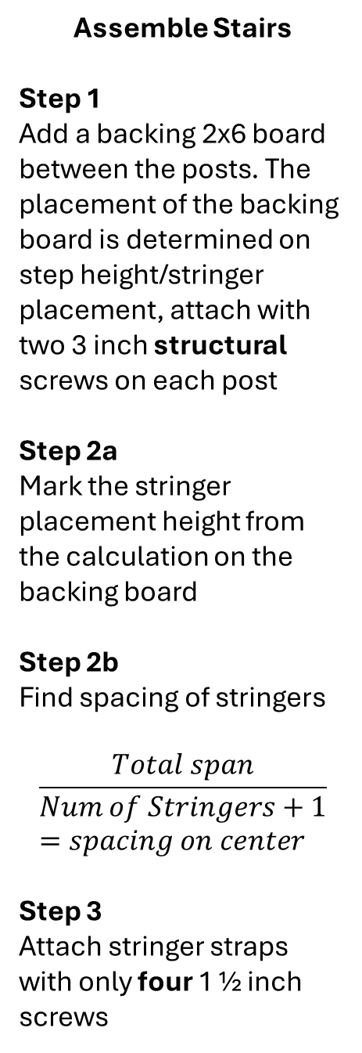
The Stairs – The Assemble 1
Assemble Stairs
Step 1
Add a backing 2x6 board between the posts. The placement of the backing board is determined on step height/stringer placement, attach with two 3 inch structural screws on each post
Step 2a
Mark the stringer placement height from the calculation on the backing board
Step 2b
Find spacing of stringers
$$\frac{Total span}{Num of Stringers+1}=spacing on center$$
Step 3
Attach stringer straps with only four 1 ½ inch screws
Note, stringer placement height and the stringer strap placement will be different
Total Span
Stringer Strap

Slide 48
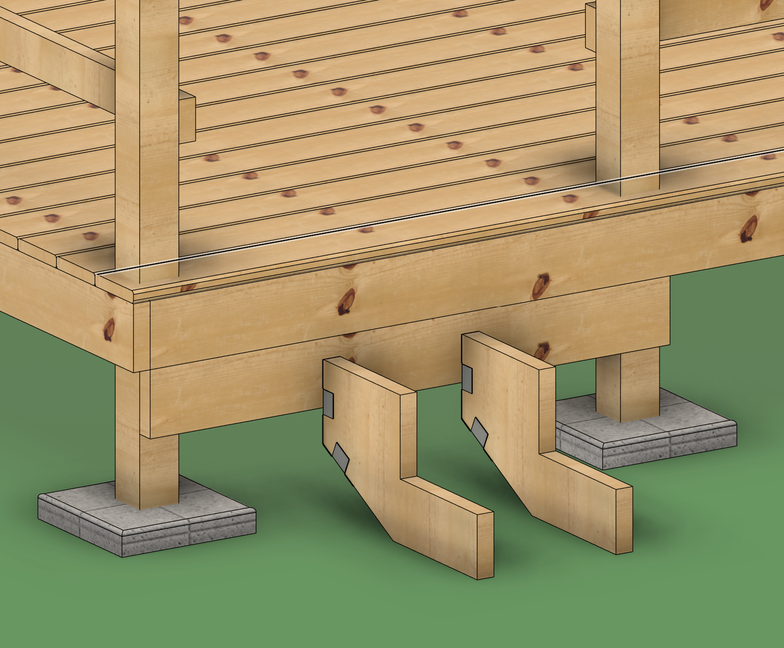
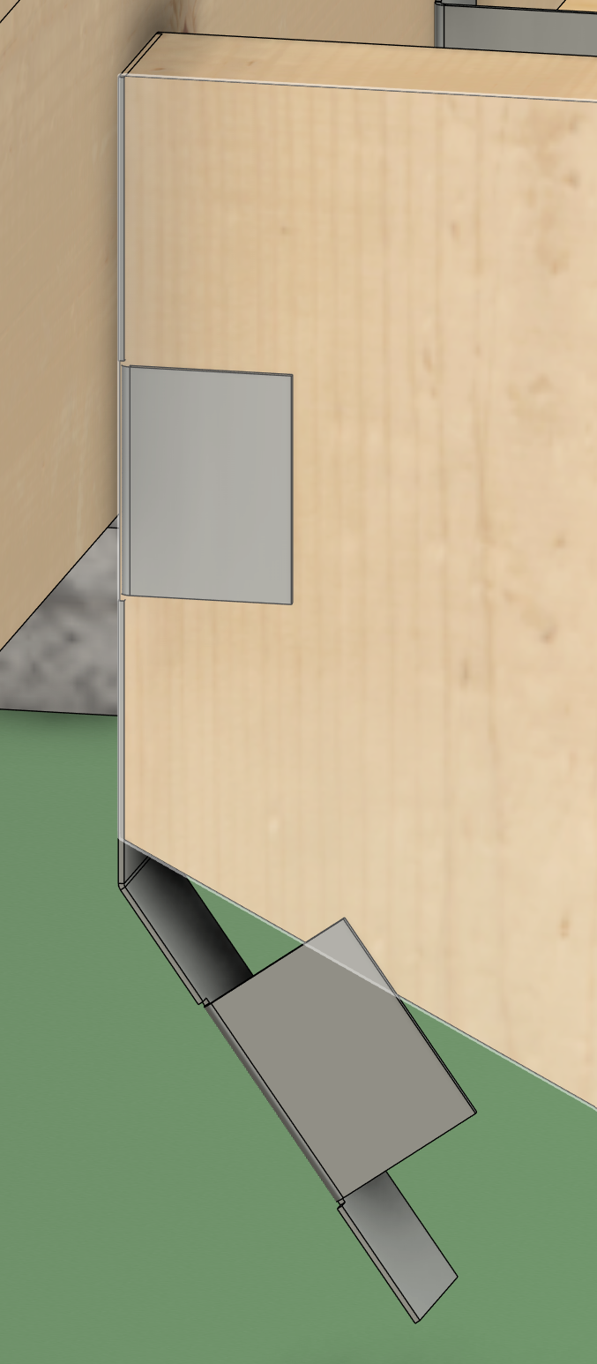

The Stairs – The Assemble 2
Assemble Stairs
Step 4a
Place the stringer straps so they line up with the placement height line, and bend the stringer strap to the angle of the stringer
Step 4b
Attach stringers with four 1 ½ inch screws per each tab
Step 5
d

Slide 49



Extra – Ending of post considerations
Assemble Stairs
One:
When adding stairs to a design make sure you have clearance for your stringers
Two:
2 posts that are to close together to have 2 deck blocks can use a paver
Three:
To get a frame close to a house, or to avoid other objects, a paver can be used in place of a deck block
Not good
1
2
Not good
Not good
3

Slide 50


Skill - How to cut an angle?
Move the bottom track on the Miter Angle Setting to the desired angle
Lock the arm in place
Skill - How to Level a Post

Slide 51
Skill - How to make weird cuts in deck boards?
DHAIOIJ

Slide 52
Skill - How to Use a Joist Hanger
DHAIOIJ

Slide 53
Skill – How to set slope on a box

Slide 54
Design Guide - Rules of Life
Major Structural Connections with Screws
  Major Structural connections ( Frames to Posts) Should have 1 inch of clear wood from the top and bottom edges
Twisting Post Considerations
  4x4 Posts that have an unsupported lateral length of 36 inches should be laterally supported
Door Considerations
  There should (ideally ) be a 5x5 space in front of entry points

Slide 55
Design Guide - Rules of The Ramp
Boxes
  Made from 2x6 lumber, using 3-inch deck screws, three per connection
  Last Box
    When cutting a box width, no more than 1.5 inches should be cut from the 2x6
Handrails
  Top and middle rails are made from 2x4s, using 3-inch screws
  When transitioning from sloped to a non-sloped section, use a full length (>20 inches) 2x4 cleat attached to the 4x4. To support the top, middle rails, and deck board
Decking
  Made with 5/4 deck board, using 2-inch screws. Using 6 screws per board
  No spacing is needed between when attaching deck boards
Hanging Frames
  You must have support on all 4 corners of a box
    Either through a cleat or a bracket

Slide 56
Design Guide - Rules of The Deck
Frame
  Are made from 2x6 lumber, using 3-inch screws, three per connection
Posts
  The default for a deck is to have all posts inside the frame, unless the structure of the building requires outside posts, or a ramp is being attached to the deck.
    If a Ramp is being attach the whole side of that deck's posts need to be on the outside
Joists
  Made with 2x6 lumber, using joist hangers and 3-inch screws
  The main structural strength comes from the joist hanger
  They should be spaces no more the 24 inches apart
Decking
  Made with 5/4 deck board, using 2-inch screws per joist.
  Decking is preferred to run with the house

Slide 57
REF
How to Space Deck Boards the Right Way –ProWood
https://www.fastenersplus.com/cdn/shop/files/SST_LSC_product_guide.pdf?v=5627474426462692043
1 ½ in screws
  https://icc-es.org/wp-content/uploads/report-directory/ESR-3046.pdf
  https://icc-es.org/wp-content/uploads/report-directory/ESR-2442.pdf
  https://spax.us/products/t-star-plus-flat-head-hcr-x
  https://www.drjcertification.org/report/download/1936/Duly%20Authenticated%20Report%20for%20SPAX%20Construction%20Screw%20Properties%20-%20DrJ%20TER%202010-02.pdf

Slide 58
Search results for Hammer - Flaticon

